Slide 1
SNAC & SLAC WRIST

Slide 2
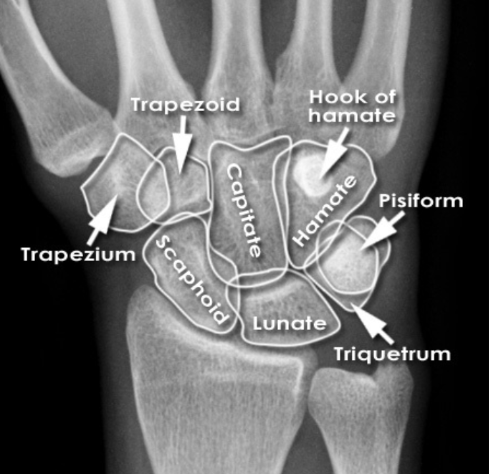
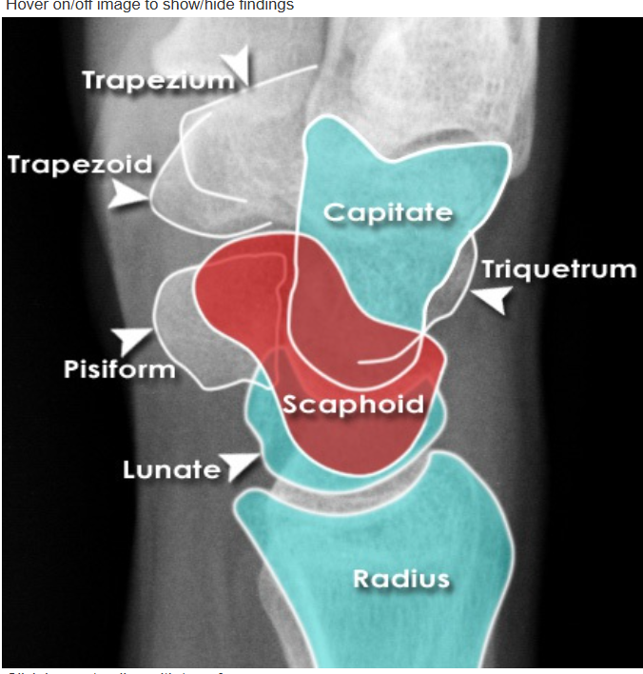

Slide 3
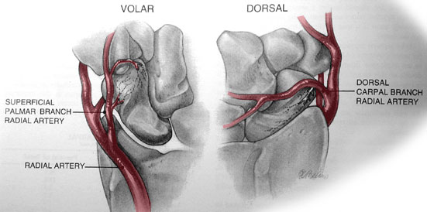
Scaphoid blood supply

Slide 4
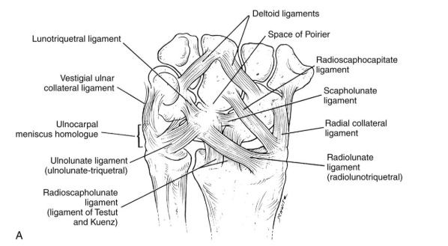

Slide 5
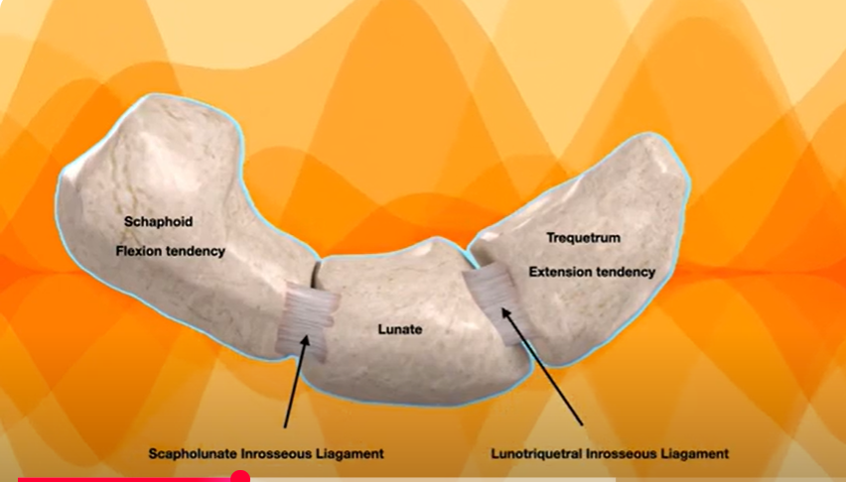

Slide 6
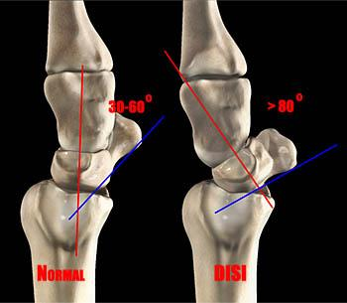

Slide 7
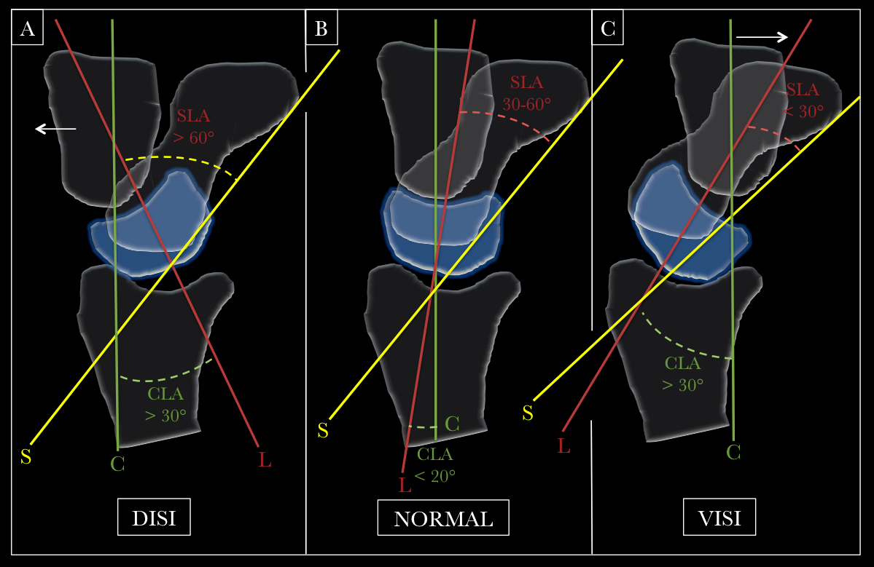

Slide 8
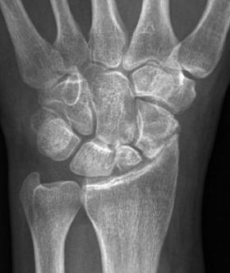
Scaphoid Nonunion Advanced Collapse (SNAC)

Slide 9
specific pattern of progressive arthritis of the wrist that results from a chronic scaphoid nonunion.
clinically - progressive wrist pain and wrist instability
natural history of degenerative changes first occurs at the radioscaphoid area followed by pancarpal / midcarpal arthritis

Slide 10
In a SNAC wrist, the proximal scaphoid fragment usually remains attached to the lunate (which rotate together during extension), while the distal scaphoid fragment rotates into flexion.
This results in abnormal contact in the radioscaphoid compartment leading to arthritis changes

Slide 11
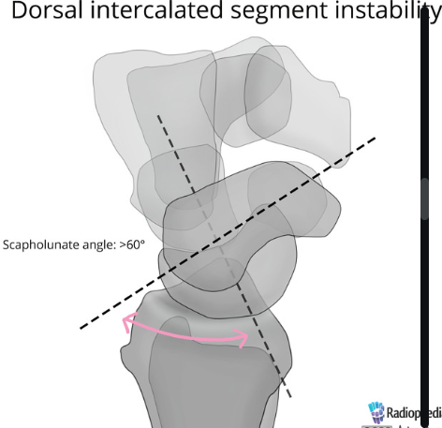

Slide 12
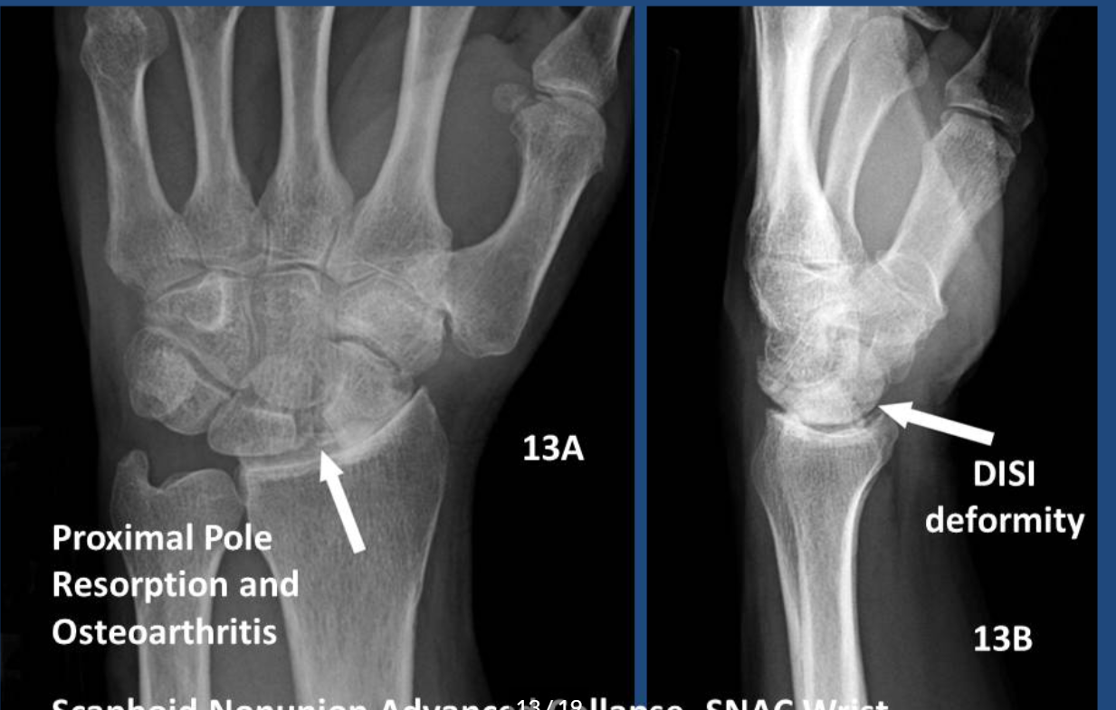

Slide 13
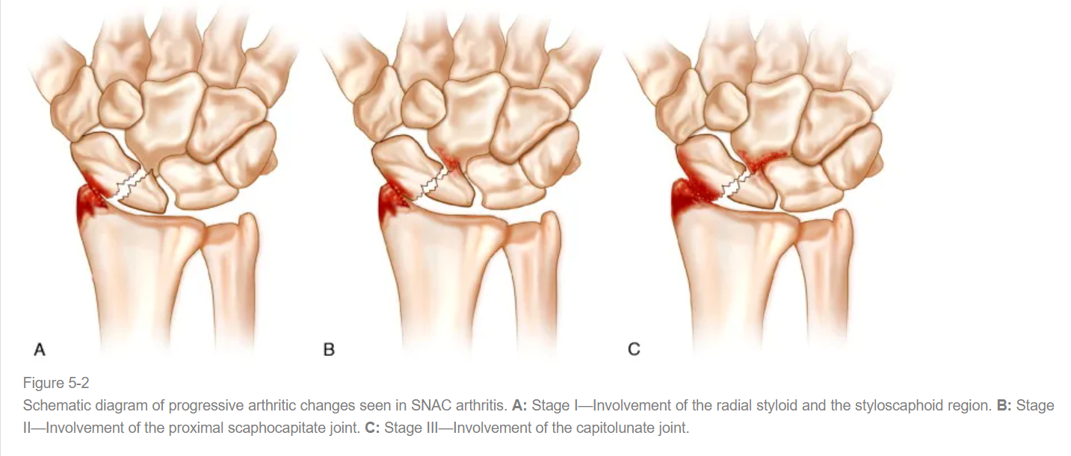

Slide 14
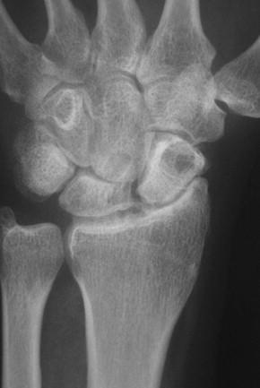
Scaphoid Lunate Advanced Collapse (SLAC)

Slide 15
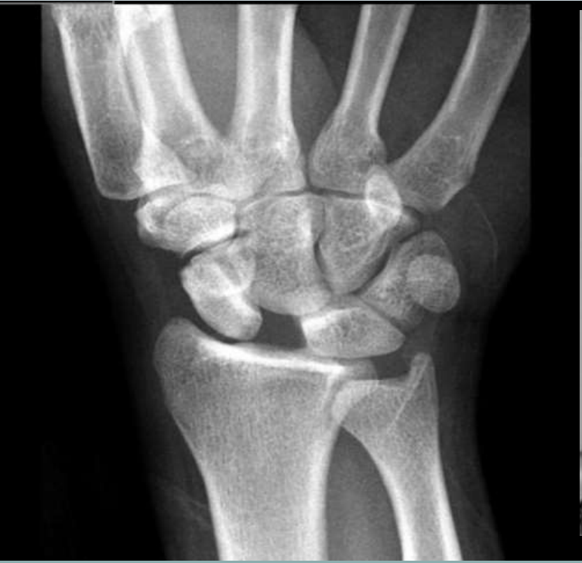
Arthritis develops due to chronic dissociation between scaphoid and lunate.
Causes:
Trauma
RA
CPPD

Slide 16
Pathoanatomy
chronic SL ligament injury creates a DISI deformity
scaphoid is flexed and lunate is extended as scapholunate ligament no longer restrains this articulation
scapholunate angle > 70 degrees
lunate extended > 10 degrees past neutral

Slide 17
Symptoms
weakness
reduced grip and pinch strength
stiffness with extension and radial deviation
Tenderness overscapholunate ligament dorsally

Slide 18
Physical exam
localized tenderness of the radioscaphoid articulation
decreased wrist motion on extension and radial deviation
Watson scaphoid shift test

Slide 19
Radiological findings
radioscaphoid narrowing,
capitolunate narrowing,
cyst formation,
pronounced dorsal intercalated segment instability(DISI)
Note: The radiolunate joint usually is spared in early stages but may show degenerative changes as the arthritis becomes more diffuse.

Slide 20
resultant scaphoid flexion and lunate extension creates abnormal distribution of forces across midcarpal and radiocarpal joints
initially affects the radioscaphoid joint and progresses to capitolunate joint
notably the radiolunate joint is spared

Slide 21
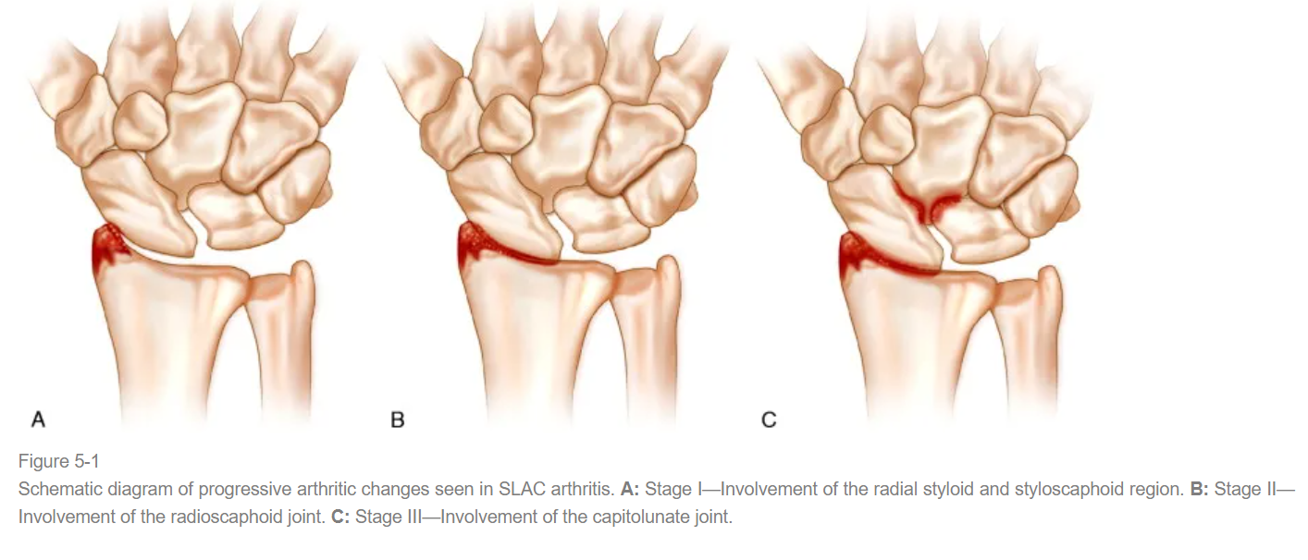

Slide 22
Treatment
Non op management
Rest
NSAIDS
Splint
Activity modification

Slide 23
Surgical management
Stage 1 SLAC/SNAC
PIN & AIN denervation
radial styloidectomy plus scapholunate reduction and stabilization
distal pole excision- can increase the DISI instability

Slide 24
Proximal row carpectomy
Stage II
PRC involves excising the scaphoid, lunate, and triquetrum
the capitate to articulate with the radius.
Intact cartilage of the capitate and lunate fossa of the radius and preservation of the RSC ligament are key in PRC
procedure should be avoided if there are capitate head degenerative changes

Slide 25
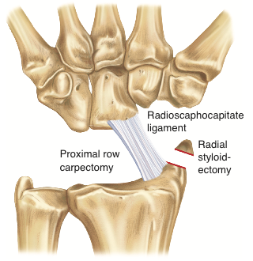
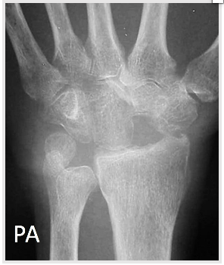

Slide 26
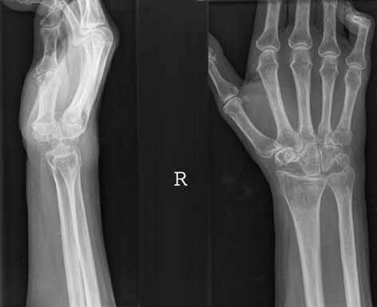

Slide 27
scaphoid excision and four corner fusion
Indications
stage II and III
retains 60% of wrist motion and 80% of grip strength

Slide 28
The procedure involves intercarpal arthrodesis of the capitate, lunate, triquetrum, and hamate bones
The scaphoid is resected
Movement through radio lunate joint and ulno carpal joint
CI: RL arthritis and ulnar carpal translation

Slide 29
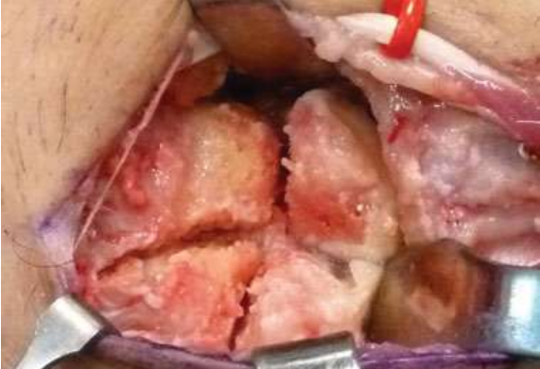

Slide 30
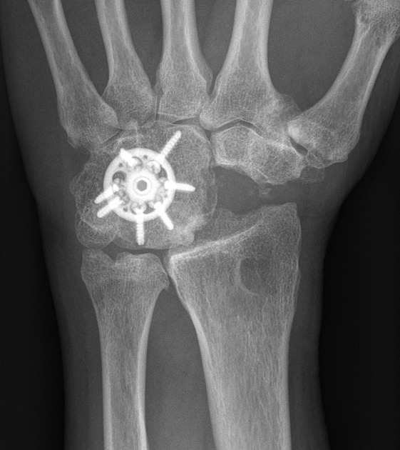
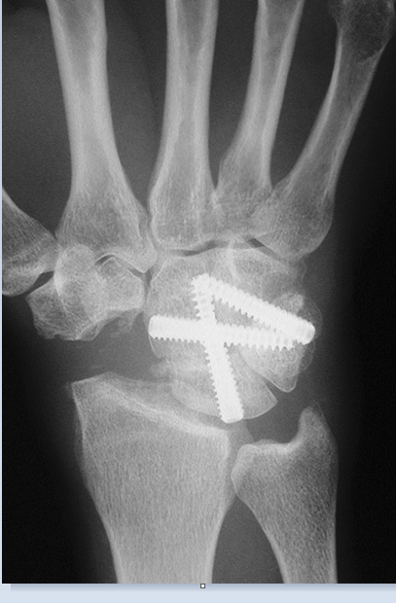

Slide 31
PRC vs FCF
the authors suggest PRC - if there is no midcarpal osteoarthritis
Simple procedure
Smaller learning curve
PRC lacks early postoperative hardware-related complications and provides comparable long-term outcomes.
Better range of movement than FCF

Slide 32
However, the risk of subsequent osteoarthritis is significantly higher in PRC patients
Grip strength, pain relief and subjective outcomes are similar in both treatment groups.

Slide 33
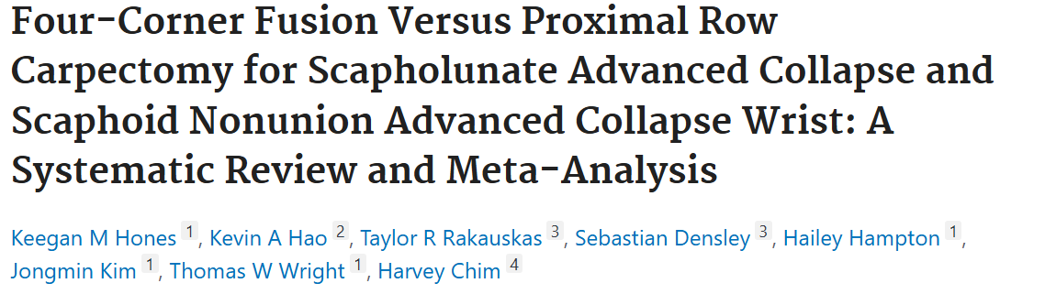
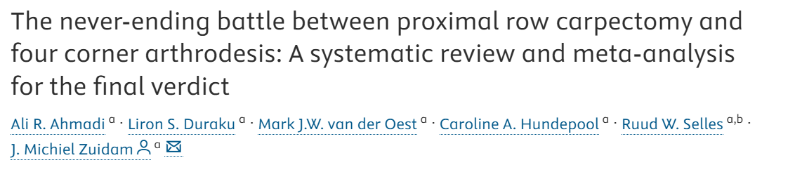

Slide 34
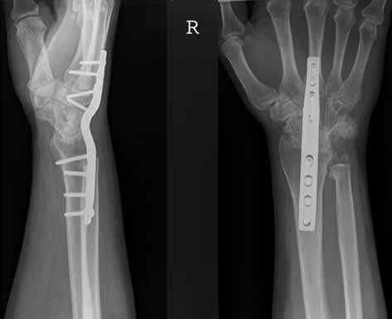
wrist arthrodesis
indications
stage II and III
Pain relief , but wrist movement is scarificed
Fuse in 10 -15 degrees if extension and slight ulnar deviation
Salvage procedure when others fail

Slide 35
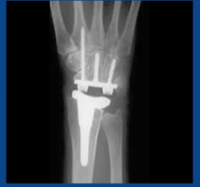
Wrist arthroplasty
Failed partial fusion
Severe SNAC/SLAC
Limited range of motion after replacememnt but good pain relief

Slide 36
Thank you

