Slide 1

Adult spasticity
Mr Adam Stoneham
BA MA (Oxon.) MBChB MRCS FRCS MFSEd.

Slide 2
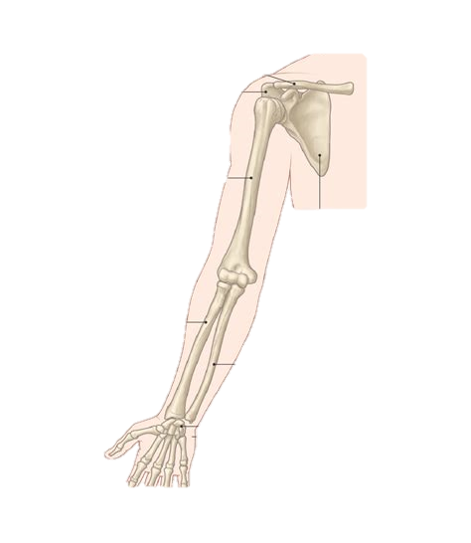
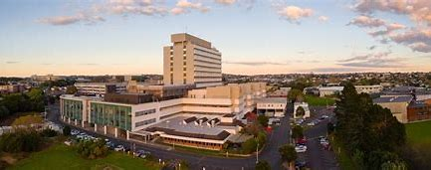



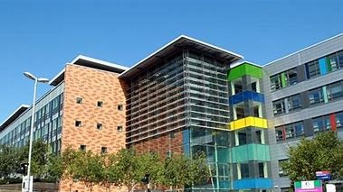
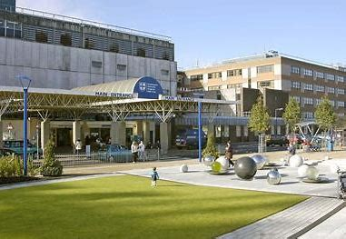


Where?
What?
Notes:
Me & my experience
WHERE?
Undergraduate degrees Oxford & Bristol graduated in 2011
1st Portsmouth in 2015 CST
Back in 2018 and did 3 years of my SpR training
Also worked in France, Australia, recently returned from a fellowship New Zealand returned for good to take up a locum consultant role
WHAT?
Throughout my training in general surgery, plastic surgery, different orthopaedic subspecialities
Treating patients children with spasticity (e.g. cerebral palsy)
Adults with spasticity affecting the spine, foot & ankle.
Further fellowship training in shoulder & elbow
Wrist & hand

Slide 3
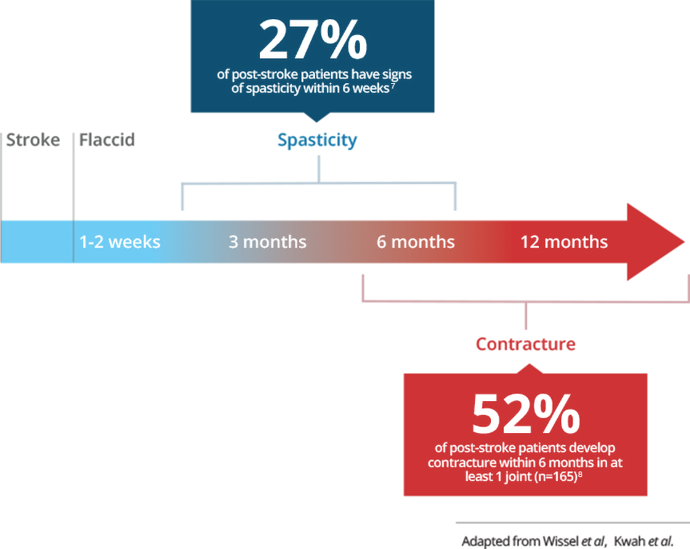
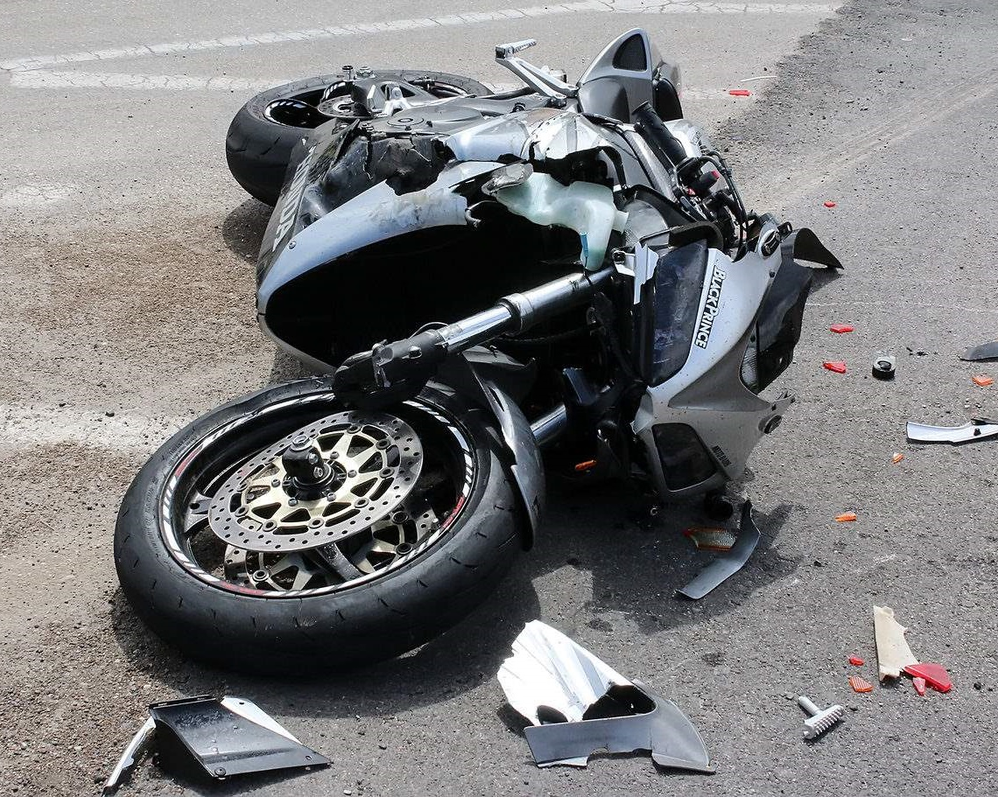
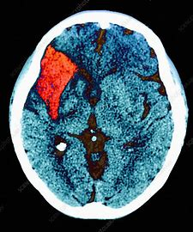
What is spasticity?
Notes:
Medical term = increased muscle tone normally in a flexed position
Difficulty relaxing
Children = CP
Adults = CP / CVA / trauma

Slide 4
1:400 live births results in CP
1.3m people live with a disability following TBI
1 CVA occurs every 5 seconds
1:5 will require institutional care

Slide 5
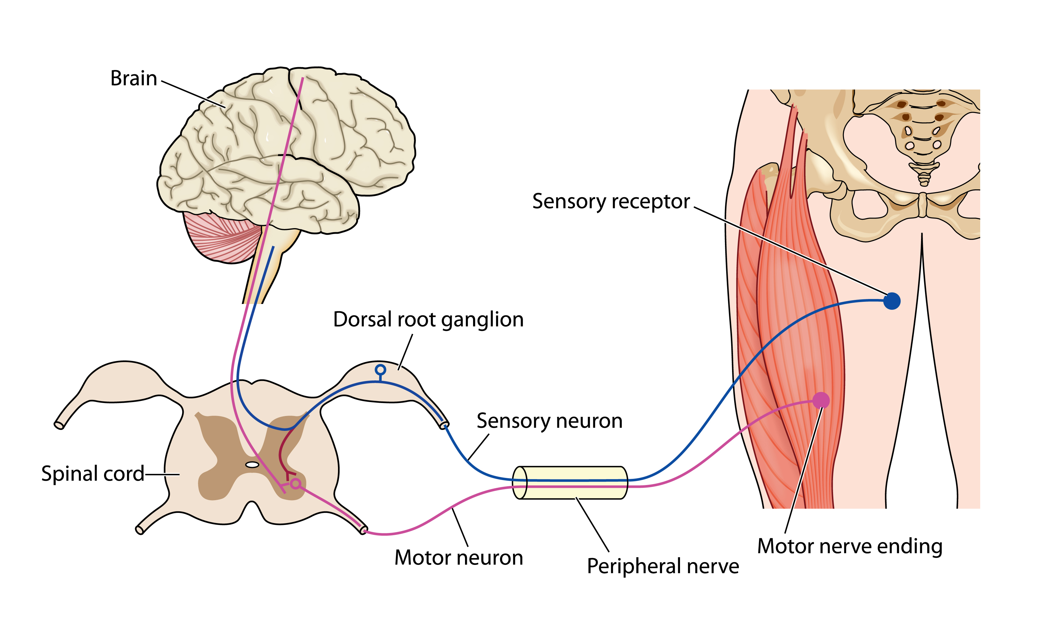
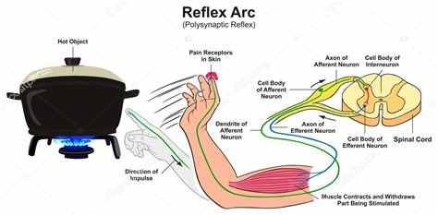
Why does it happen?

Slide 6
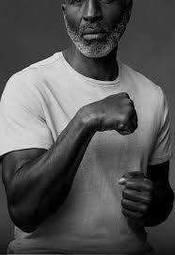

Slide 7
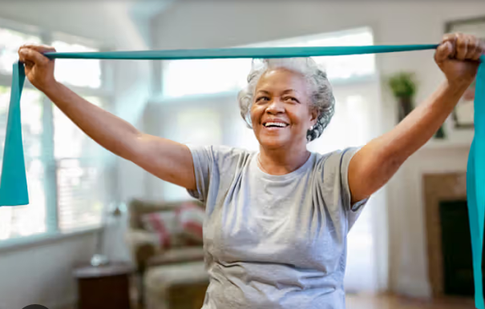
Why is it important?
Notes:
Why is this important
Clearly most important thing is to prevent the root cause
Stop it getting worse
Improve function
Idea scenario: return to work, return to hobbies and activities, regain independence, function within society

Slide 8
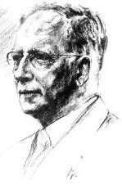
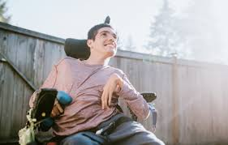
“When you have very little then a little is a lot”
Notes:
Different aims in this gentleman
Stirling Bunnell
“When you have very little, then a little is a lot”

Slide 9


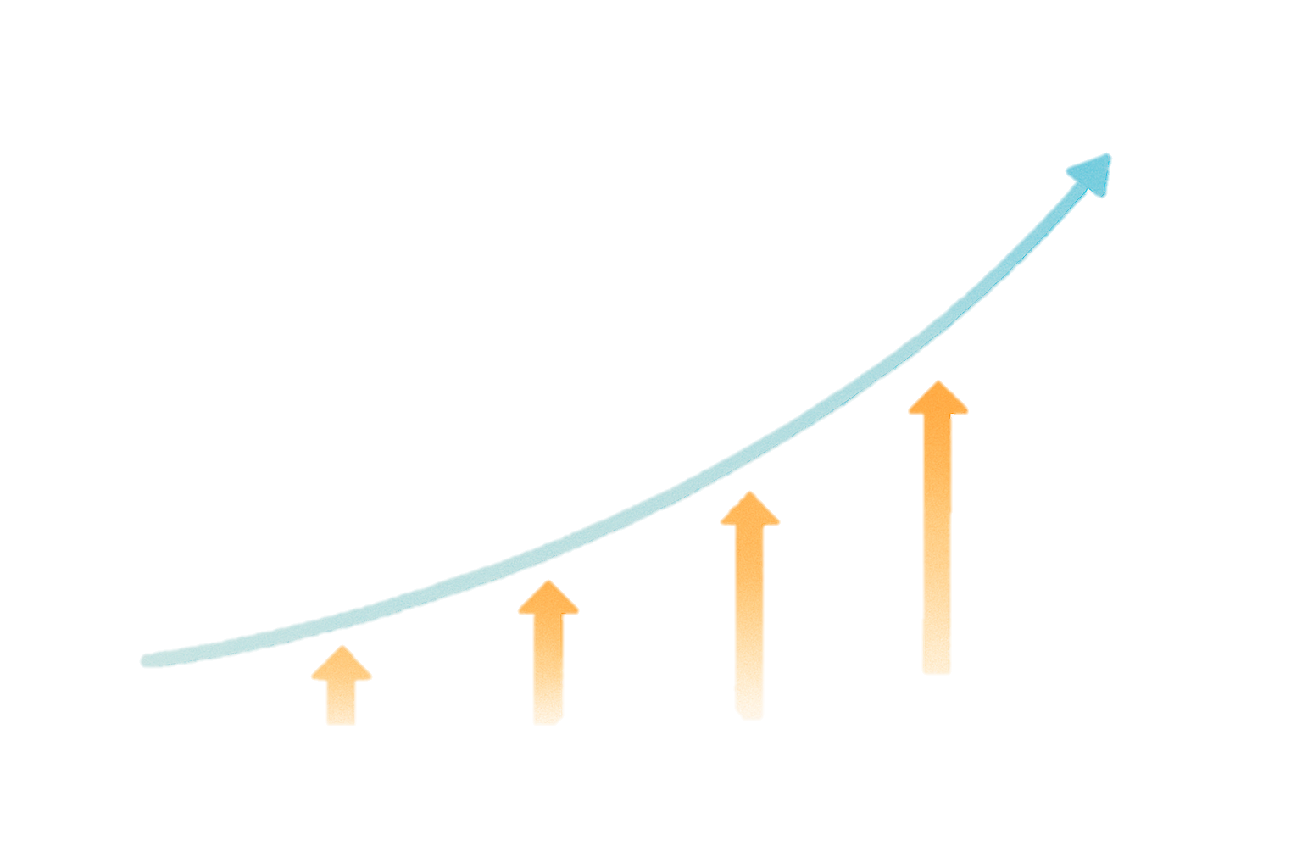
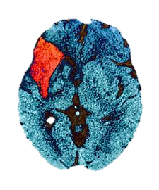
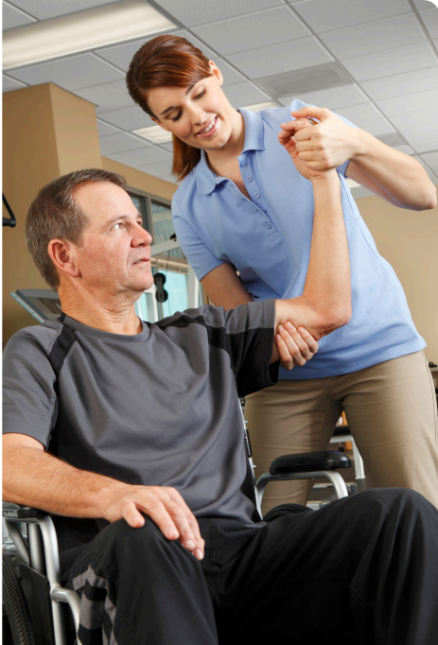
Rapid access radiology
Scope of the challenge
Clinical pathways
Better medication
Societal shift /
Pt. demand
Knowledge & treatments
survivorship
Notes:
Landscape of spasicity is changing
Increasing need
Better diagnostics & medication
Higher survivorship following childhood illness or stroke as an adult
More we can do (drugs, imaging, surgical expertise)
Greater demand from patients who deserve to live more functional pain free lives.

Slide 10
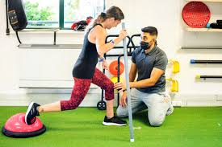
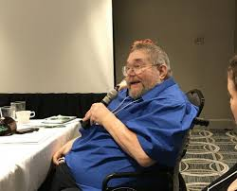

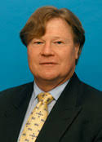
Some considerations…
“Multiple assessments by multiple professionals doing multiple things”
Notes:
Considerations
Esoteric group of patients, specific needs,
Difficult decision making
Role of MDT
UL surgeons (SKG), Radiology, plastics, hand therapy, more

