Slide 1

Paediatric Compartment Syndrome
Adam Stoneham
July 2021

Slide 2
Definition
Pressure in myofascial compartment exceeds the capillary filling pressure
Ischaemia & necrosis
Inflammation, swelling, further incr. pressure
Notes:
Devastating condition
One of a handful of true orthopaedic emergencies

Slide 3
Risk factors¹
High energy trauma
Especially MVAs (80%)
Adolescent males (v. rare <10)
Tibial shaft (40%)
Open #s > closed
Also observed in:
  Low energy injuries, vascular injuries, infection, electrocution, elective procedures (e.g. tibial osteotomy), coagulopathy, failure to remove tourniquet
Notes:
Compartment Sx rare in paedicatric population

Slide 4
Peters CL, Scott SM. Compartment syndrome in the forearm following fractures of the radial head or neck in children. J Bone Joint Surg Am. 1995 Jul;77(7):1070-4

Slide 5
Clinical presentation (theory)²
5 ‘P’s?
Pain
Pallor
Pulselessness
Paraethesia
Paralysis
3 ‘A’s?
Anxiety
Aggitation
Analgesic requirements
Mean delay 22 hours³
Notes:
Additional challenges in children
Rarity, communication barriers

Slide 6
Clinical presentation (practice)
Pain (esp. on passive stretch)
Firm compartments

Slide 7
Investigations
Compartment pressure monitoring
  Normally 0-5mmHg (adults) 13-16mmHg (children)
  Absolute value >40mmHg
  Within 20-30mmHg of diastolic pressure (Delta pressure)
Dopler USS
  Pulses still present as arterial pressure > compartment pressure
Notes:
Further investigations controversial
Clinical diagnosis confirmed or refuted in the Operating theatre

Slide 8
Treatment
Elevation, splitting of casts
Extension of limb reduces pressure²
Emergency fasciotomy and compartment decompression

Slide 9
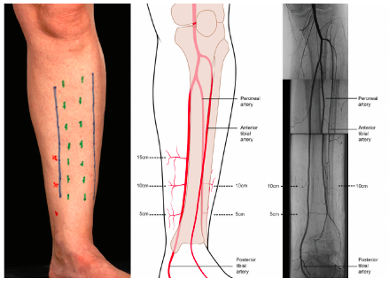

Slide 11
Notes:
Lasertus fibrosis to carpal tunnel

Slide 14
Neonatal compartment syndrome⁴
And finally…
Newborn baby
38/40
Forceps delivery
Erythema + bullae R arm started yesterday
Dermatology review “non-specific”
Notes:
Rare (20 cases in 20 years) ; presents late (diagnosis often retrospectively) or mistaken for other pathology (e.g. nec fasc.)
Presents differently – skin changes
Extrinsic vs intrinsic causes

Slide 15
Key learning points
Suspicion of compartment syndrome in all patients experiencing pain out of proportion to injury
Careful evaluation, re-evaluation and documentation
It is an intraoperative diagnosis

Slide 16
References
Rockwood & Wilkins Fractures in Children 7th Edition
Hak DJ. Acute Compartment Syndrome in Children. 2019 Sep 3. In: Mauffrey C, Hak DJ, Martin III MP, editors. Compartment Syndrome: A Guide to Diagnosis and Management
Ramachandran M, Skaggs DL, Crawford HA, Eastwood DM, Lalonde FD, Vitale MG, Do TT, Kay RM. Delaying treatment of supracondylar fractures in children: has the pendulum swung too far? J Bone Joint Surg Br. 2008 Sep;90(9):1228-33
Prasarn ML, Ouellette EA, Livingstone A, Giuffrida AY. Acute pediatric upper extremity compartment syndrome in the absence of fracture. J Pediatr Orthop. 2009;29:263–8

