Slide 1
The Orthopaedic OSCE
don’t put your foot in it
Mr Adam Stoneham

Slide 2
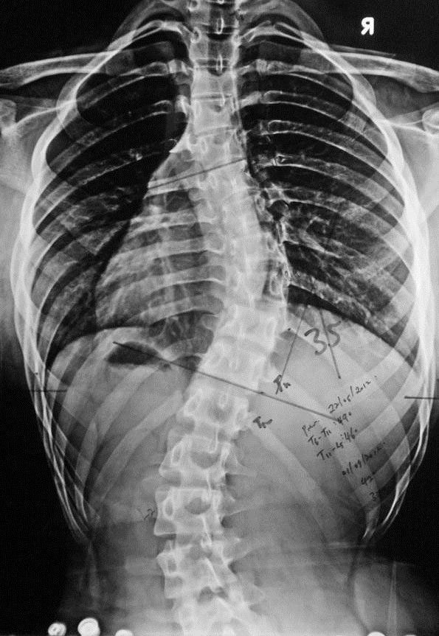
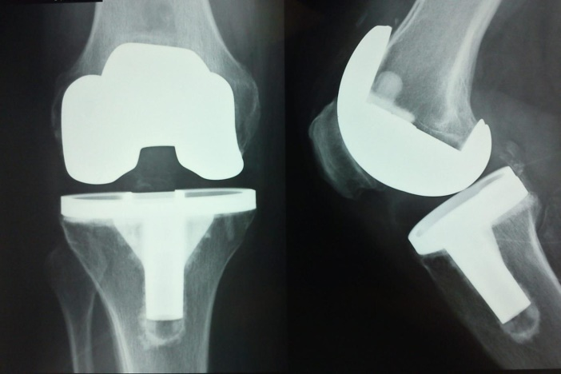
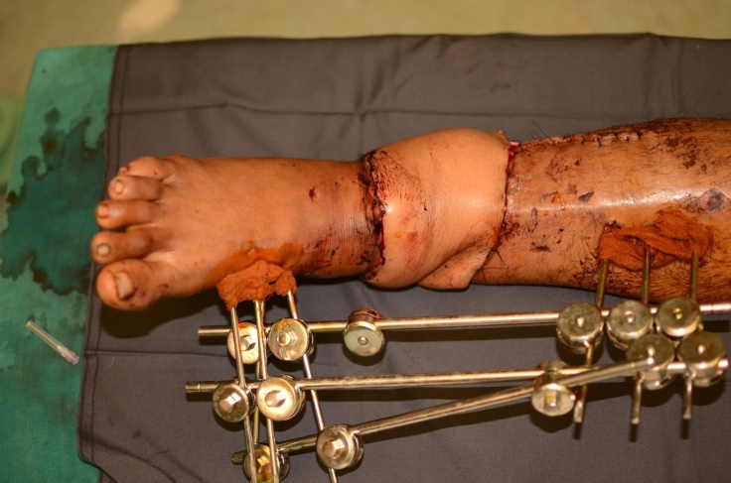
Why?
What?
Where?
Notes:
You’re allowed to be snobby about Orthopaedics but you are not allowed to think it’s easy

Slide 3
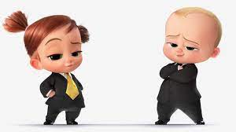

Slide 4
What is the point of the Orthopaedic OSCE?

Slide 5
Come up with a sensible diagnosis Establish what the patient wants Be safe / don’t make a TIT of yourself

Slide 6
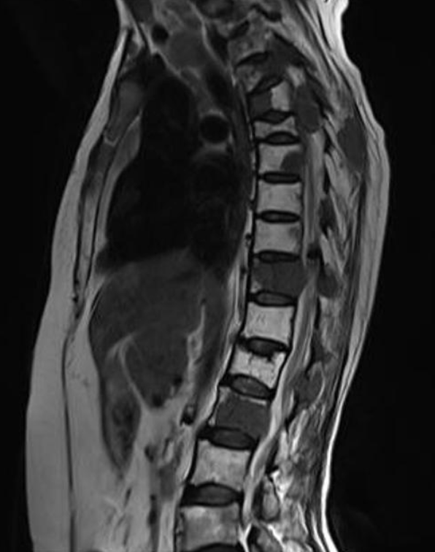
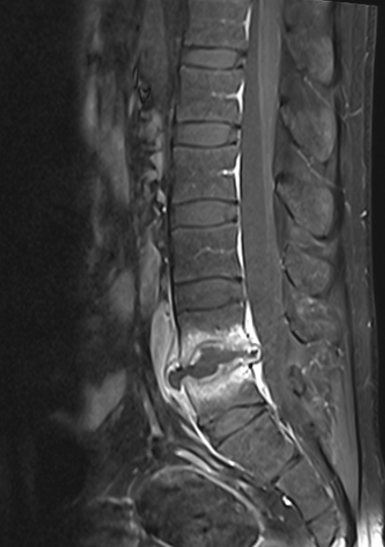
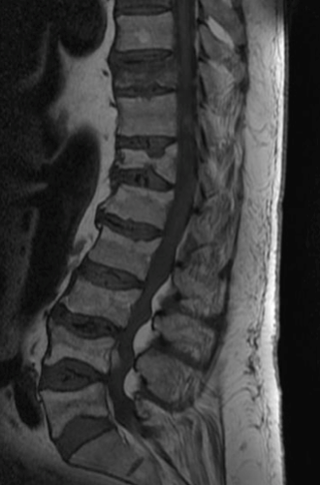
Tumour
Infection
Trauma

Slide 7
What are they going to ask?

Slide 8
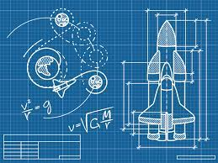

Slide 9
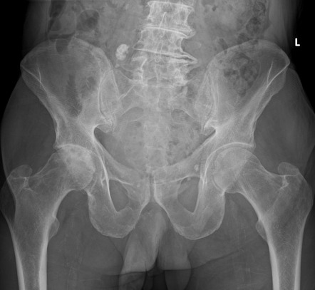
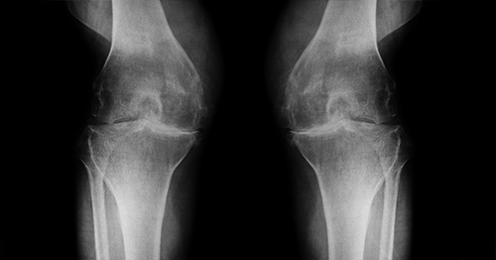

Slide 10
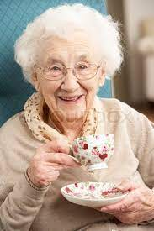
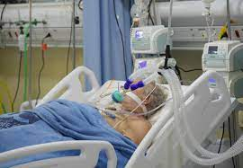

Slide 11


Slide 12
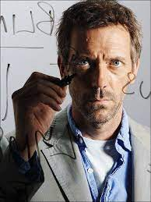

Slide 13
The Orthopaedic OSCE
History
Examination
Investigations
Treatment
Cases
Notes:
You’re allowed to be snobby about Orthopaedics but you are not allowed to think it’s easy

Slide 14
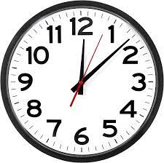
Orthopaedic History Come up with a sensible diagnosis Establish what the patient wants Be safe / don’t make a TIT of yourself

Slide 15
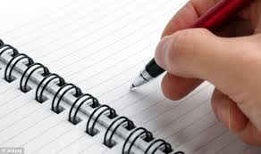
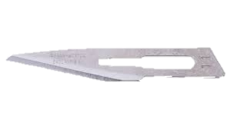
PC HPC PMH PSH (FH) SH
Pain
Loss of function
Get up, get dressed, make a cup of tea, put your socks on, get in the car, go to work…
TELL ME ABOUT YOUSELF

Slide 16
Orthopaedic Exam Confirm or refute your diagnosis Seek alternate diagnosis Don’t hurt the patient **DEMONSTRATE KNOWLEDGE & TECHNIQUE**

Slide 17

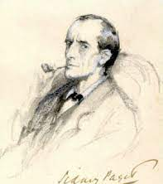
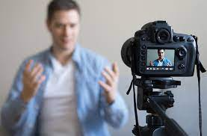
LOOK - symmetry - scars - swelling FEEL - vascularity - sensation MOVE - active / passive - good / bad XRAY “to complete my examination…”
Notes:
Driving test: practice saying what you are doing. Record yourself.

Slide 18
Investigations

Slide 19
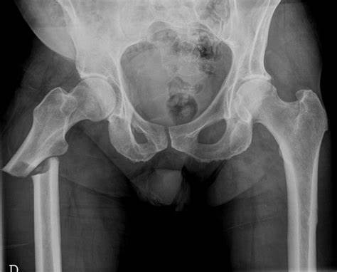
Mrs Smith
02/15/1931
AP
26/2/21
*Red dot

Slide 20
DEMOGRAPHICS DESCRIBE DIAGNOSE DOUBLE CHECK / DUAL PATHOLOGY

Slide 21
Mrs Smith
02/15/1931
AP
26/2/21
*Red dot

Slide 22
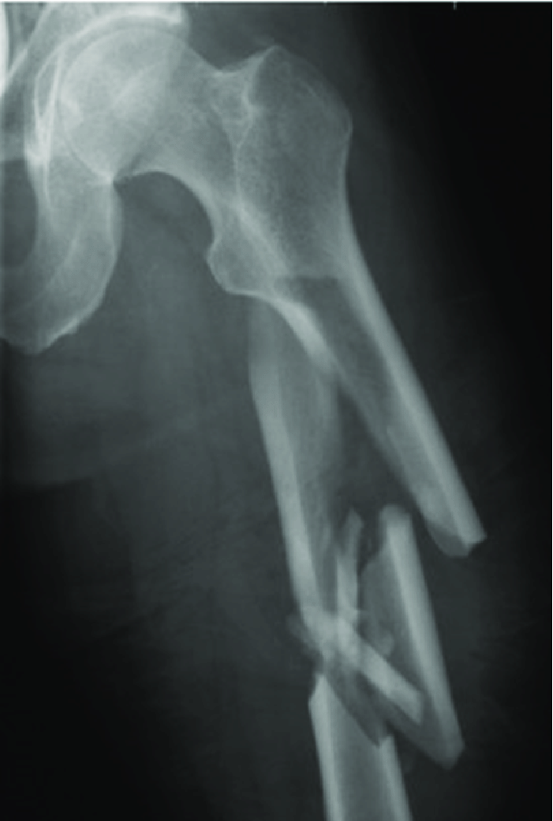
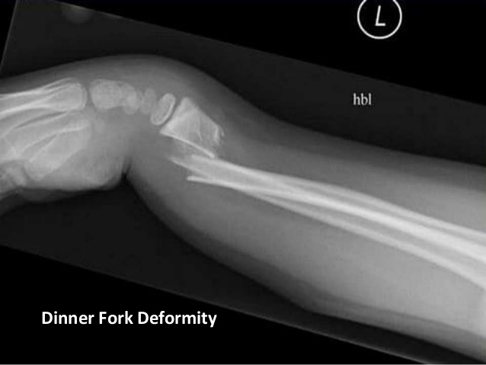
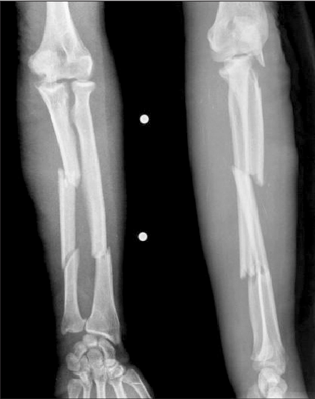
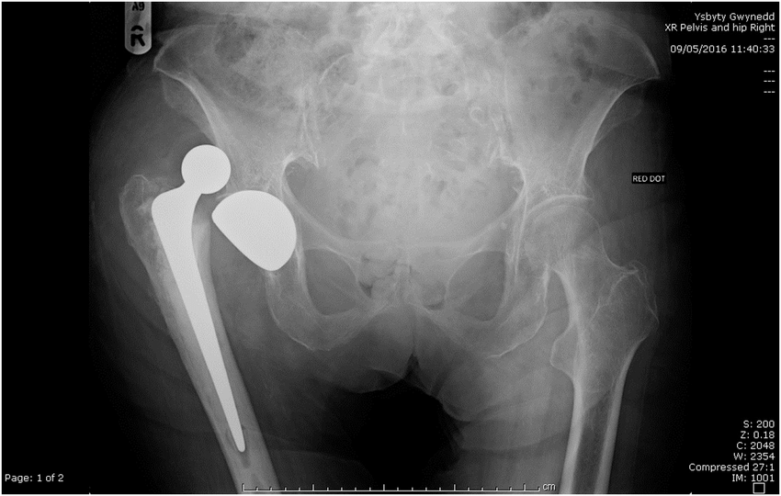
Notes:
Some to practice

Slide 23
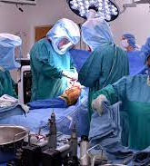
Treatment

Slide 24
CONSERVATIVE MEDICAL SURGICAL
Operative
Non-operative

Slide 25
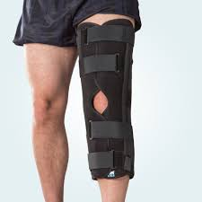

Slide 26
Cases

Slide 27
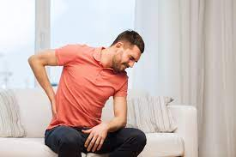

Slide 28
Cauda Equina Red flags - Bilateral sciatica - Weakness - Saddle anaesthesia - Bowel or bladder dysfunction - Sexual dysfunction

Slide 29
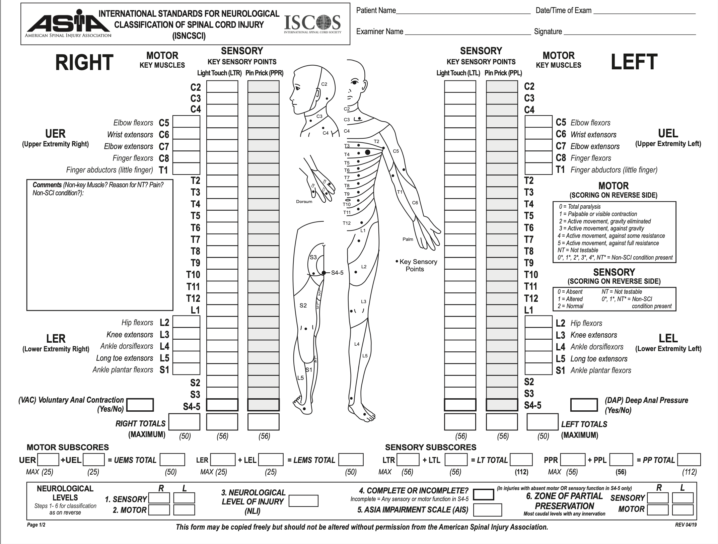

Slide 30
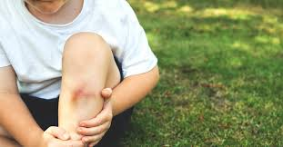

Slide 31
Pain out of proportion to clinical findings = compartment syndrome until proved otherwise…

Slide 32
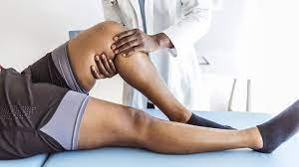

Slide 33
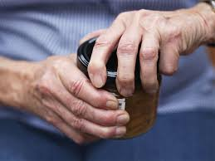

Slide 34
Resources Surgical talk OSCE exams ? Geeky medic Each other

