Slide 1
Hand emergencies

Slide 2
1

Slide 3
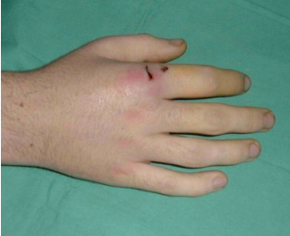

Slide 4
Acute paronychia | Staph aureus
Chronic paronychia | Candida
Human bites | Eikenella
Cat & dog bites | Pasteurella
Cat scratch | Bartonella
Florists fungal infection | Sporothrix shenkii
Dental extraction | Streptococcus
Necrotising Fasciitis | Commonest is polymicrobial
Periprosthetic joint infection | Staph epidermidis
Aquarium workers | Mycobacterium marina
Domestic birds | Commonest overall is Staphylococcus (commonest gram -ve is E.coli)
Human | Eikenella
Animal bites | Pasteurella
Scratches | Bartonella

Slide 5
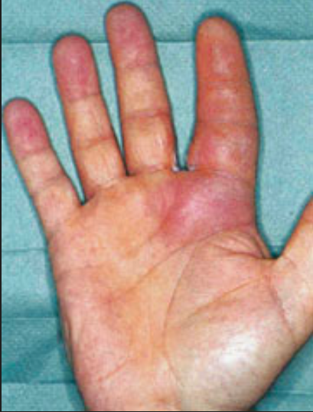

Slide 6
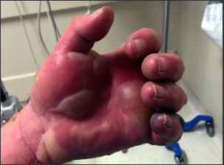

Slide 7
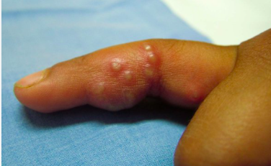

Slide 8


Slide 9
2

Slide 10
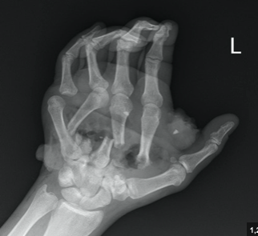

Slide 11
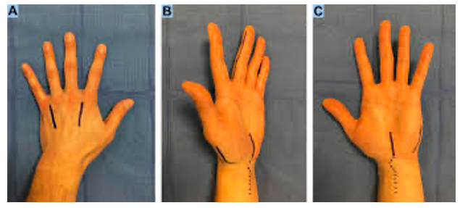

Slide 12
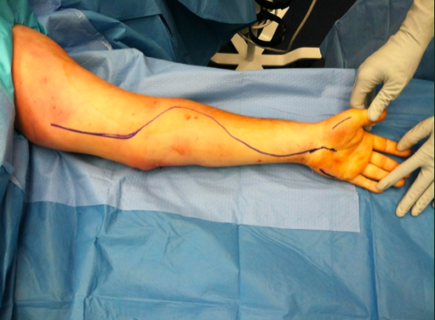

Slide 13
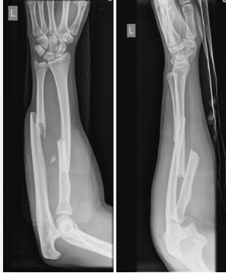

Slide 14
Volar incision:
starts just radial to FCU at the wrist
extends proximally to the medial epicondyle.
Dorsal incision:
starts 2 cm distal to the lateral epicondyle toward the midline of the wrist
EDC / ECRB

Slide 15
3

Slide 16
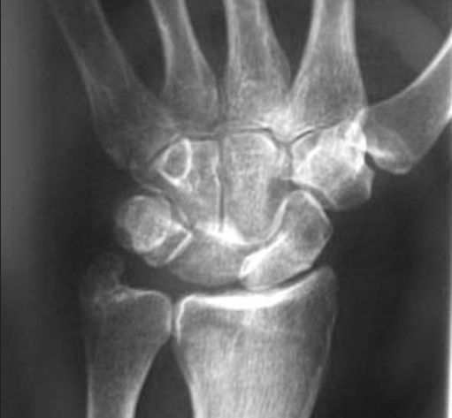

Slide 17
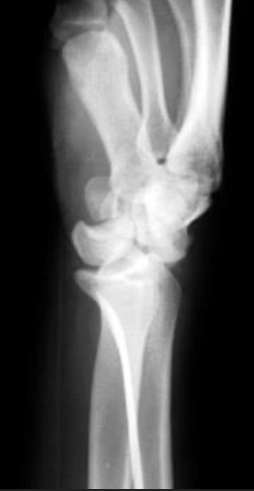

Slide 18
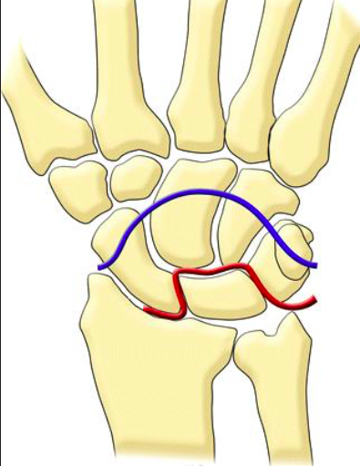

Slide 19
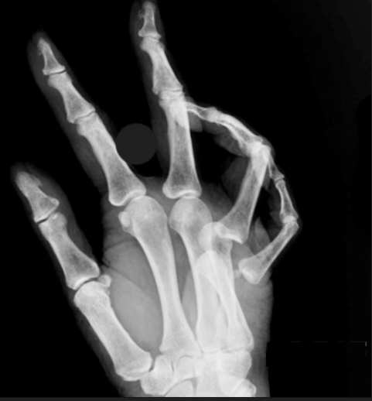

Slide 20
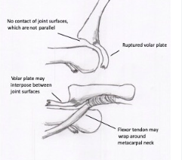
Notes:
Kaplan’s lesion

Slide 21
4

Slide 22
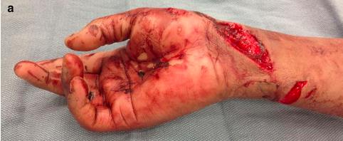

Slide 23
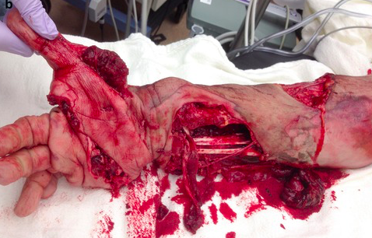

Slide 24
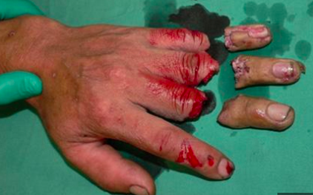

Slide 25
Indications include:
Thumb Amputation: High functional and aesthetic importance for opposition and grasp.
Multiple Digits Amputated: Restoring hand function by replanting several digits.
Amputation in Children: Better healing potential and greater long-term functional benefits.
Clean-Cut Injuries: Sharp amputations have better outcomes due to reduced tissue damage.
Amputation at the Distal Phalanx: Suitable for replantation due to minimal tissue and vessel damage.
Patient Motivation and Compliance: Replantation is more successful if the patient is committed to postoperative rehabilitation.
Contraindications include:
Severely Crushed or Avulsed Injuries: Extensive damage to soft tissues, vessels, and bones limits replantation success.
Severe Contamination: High infection risk in contaminated wounds.
Prolonged Ischemia Time:
Warm ischemia >6 hours.
Cold ischemia >12 hours for proximal injuries (shorter tolerances for muscle-rich segments).
Digital amputations proximal to FDS insertion: Injuries proximal to FDS insertion at the base of the middle phalanx leads to stiff PIP and DIP joints which are poorly tolerated
Severe Comorbidities: Diabetes, peripheral vascular disease, or other conditions impairing healing and circulation.
Non-Dominant Hand with Single-Digit Injury: Minimal functional gain compared to surgical and rehabilitation efforts.
Uncooperative Patient or Poor Rehabilitation Potential: Poor compliance reduces long-term outcomes.
Life-Threatening Injuries Elsewhere: Replantation is contraindicated if it delays stabilization of critical injuries.

Slide 26
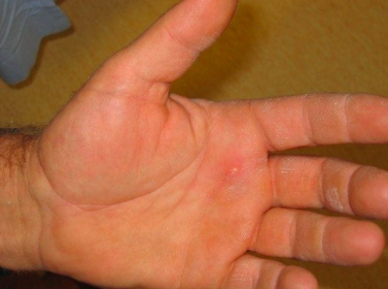

Slide 27
Pressure (psi) | Amputation Rate (%)
<1000 | 19
1000-7000 | 43
>7000 | 95-100
Material | Amputation rate (%)
Solvent based paint | 80
Oil based paint | 70
Grease | 20
Air / water | <20

Slide 28
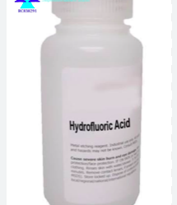
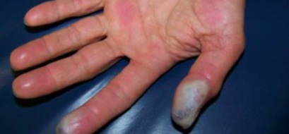

Slide 29
Hydrofluoric acid (HF) is an exceptionally potent inorganic acid and a strong dehydrating agent widely used across various industrial sectors. While domestic HF concentrations are typically around 0.5%, industrial formulations can reach nearly 100%.
HF is highly toxic and destructive, capable of penetrating deep tissues, causing liquefactive necrosis and the release of cellular components. Accidental or intentional exposure to HF through ingestion, inhalation of fumes or vapours, or dermal contact can result in severe dermal burns, eye injuries, acute respiratory distress, and systemic fluoride toxicity.
Emergency management:
Take appropriate personal protective measures
Address airway compromise if present
Monitor and treat for cardiac arrhythmias
Initial treatment steps:
Immediately remove contaminated clothing, jewellery, and items trapping HF; double-bag them to prevent secondary exposure
Begin decontamination using copious amounts of water, saline, or soap and water solution
Apply neutralizing agents:
Calcium gluconate gel 2.5% should be gently massaged into the affected area for 15–30 minutes, with reapplication every 10–15 minutes as needed. The gel turns white as calcium binds with fluoride ions to form calcium fluoride (CaF). For definitive treatment, 2.5% calcium gluconate should be applied 4–6 times daily for a duration of 3–4 days.
If pain persists beyond 30 minutes, subcutaneous infiltration of calcium gluconate is recommended at a dose of 0.5 mL of a 5% solution/cm²

Slide 30
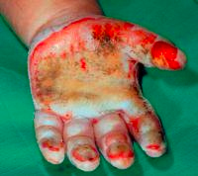

Slide 31
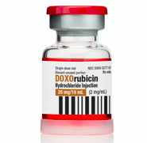

Slide 32
