Slide 1
FRCS exam

Slide 2
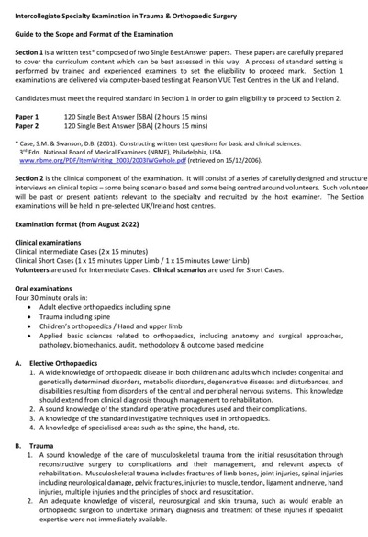
www.jcie.org.uk

Slide 3
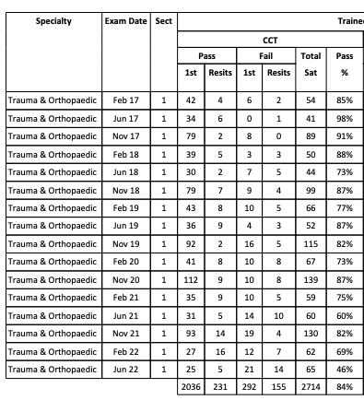
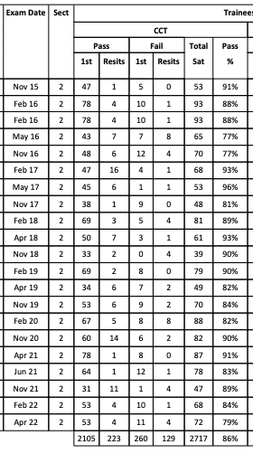

Slide 4
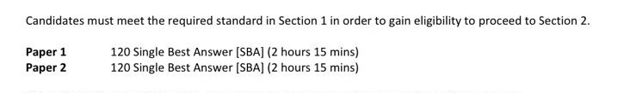
Section 1

Slide 5
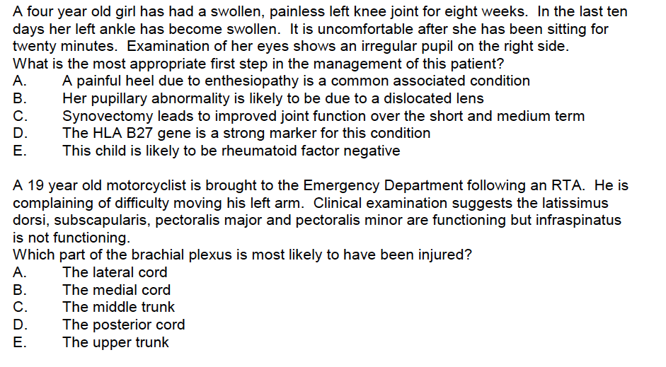

Slide 6
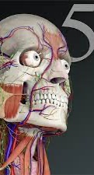
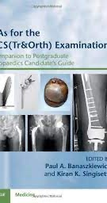
Resources
There is no perfect resource!
Orthobullets
UKITE past & present
SBA for FRCS (Tr&Orth) Banasziewicz
Essential Anatomy app
Flashcards app

Slide 7
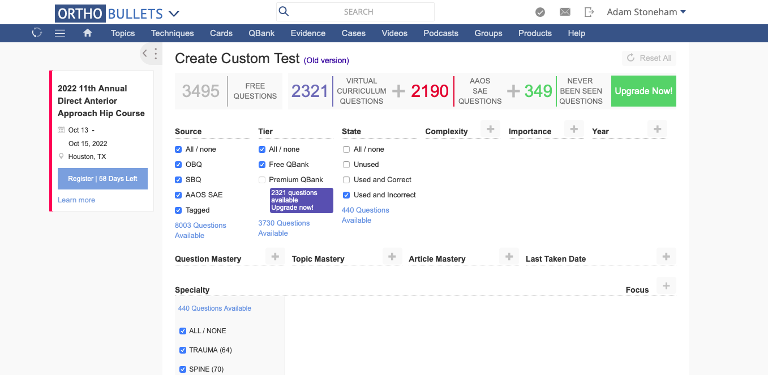

Slide 8
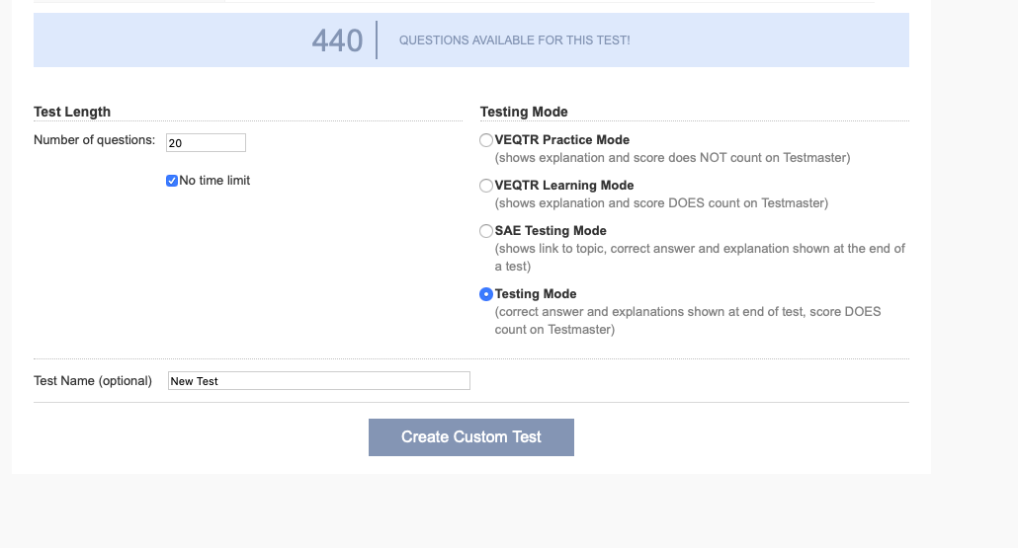

Slide 9
3rd November 2021
16th February 2021

Slide 10
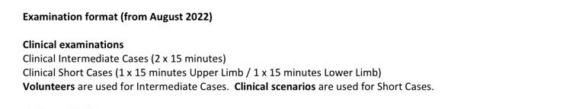
Section 2
Oral examinations (vivas) 30 minutes each
Elective Orthopaedics
Trauma
Children's Orthopaedics / Hand & Upper limb
Basic Science

Slide 12
My UL long case
Describe the photograph
What clinical features do you notice?
What is the likely pathology?
What operation has she had?
What else do you need to be mindful of if you are considering surgery?
She how has pain on the other side; what are the treatment options?
Describe surgical approach for wrist fusion

Slide 13
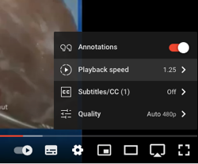
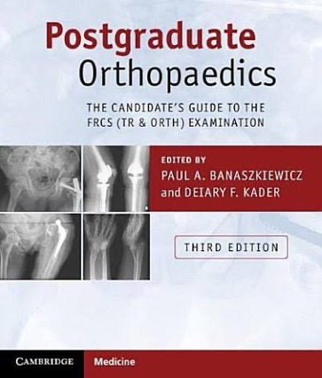
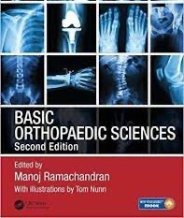
Resources
Each other
Courses
Millers Review
Chesterfield
Let’s Talk Dr
Orthopaedic Research UK
Study Groups
Personal Study
Text books
Banasziewicz
Ramachandran
Mock Exam
Orthobullets (and other) podcasts
YouTube* eg Quen Tang, Pulvertaft

Slide 14
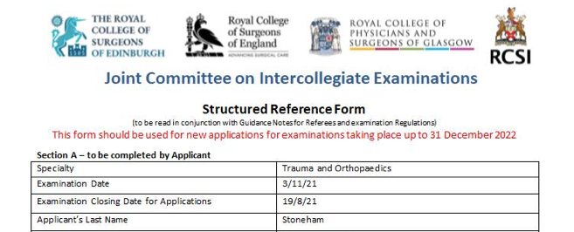
Next steps
6th February 2022
PART B
https://www.jcie.org.uk/
3rd November 2021
PART A
18th August 2021
Application deadline
8th August 2021
Last referee responds
May 2021
1st referee responds
6th February 2021
Start revising

