Slide 1
Deltopectoral approach

Slide 2

Deltopectoral approach
Indications
Setup
Incision
Superficial dissection
Deep dissection
Extension
and
Risks

Slide 3
Indications
Indications
Setup
Incision
Superficial dissection
Deep dissection
Extension
and
Risks
‘Workhorse’ approach for
Elective
Arthroplasty
Stabilization
Rotator cuff work
Trauma
Fractures of proximal humerus…
…and glenoid
Infection
Alternatives…?

Slide 4
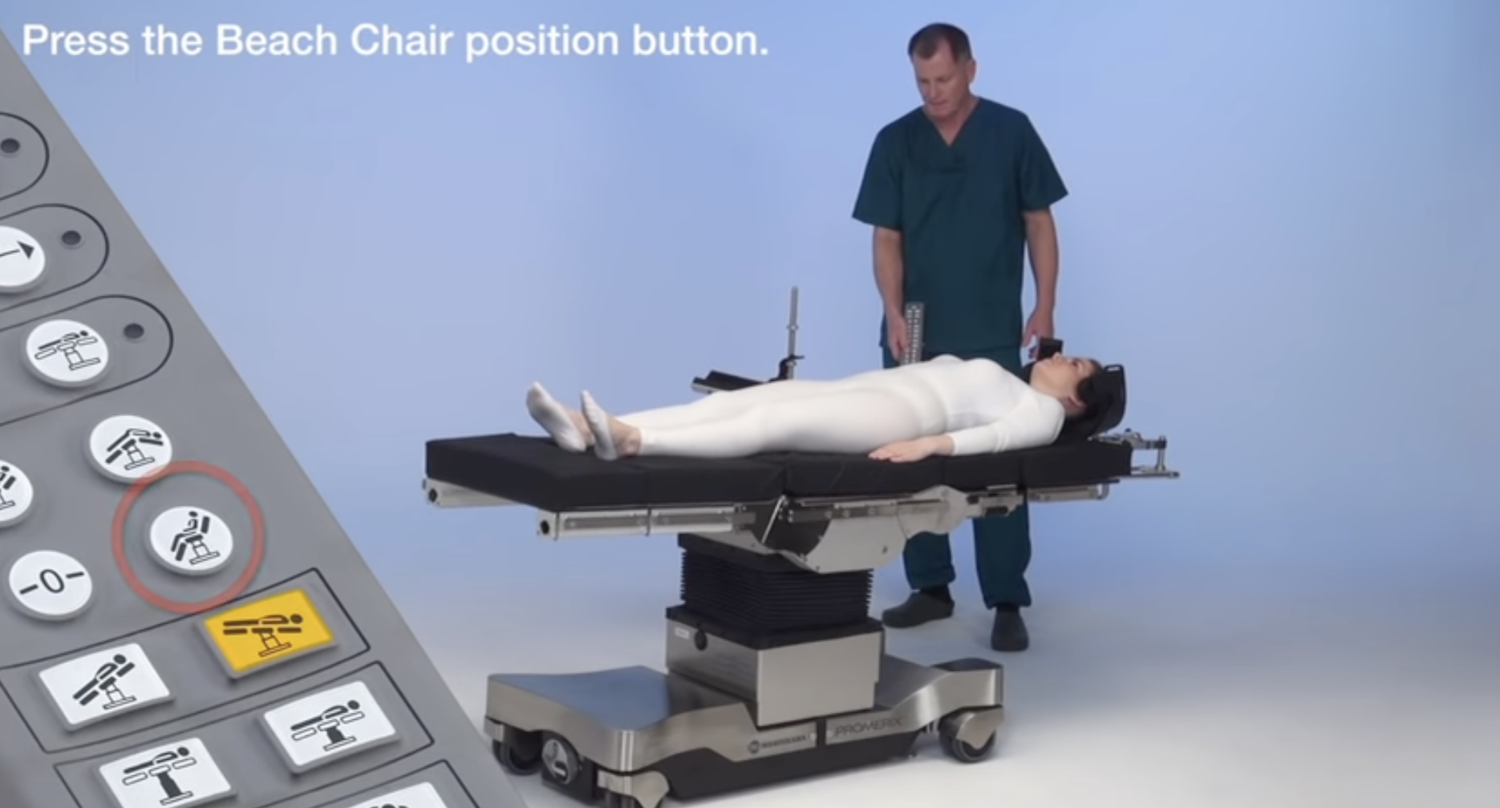
Setup

Slide 5
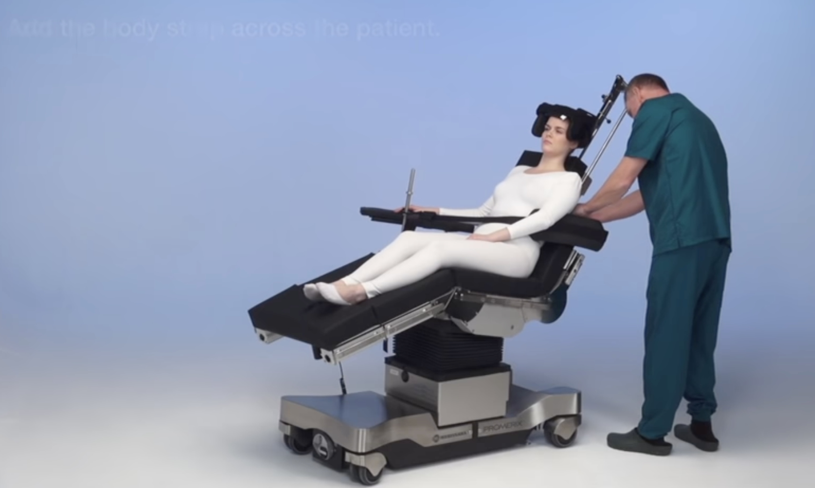
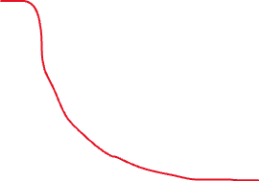

*
*
*

Slide 6
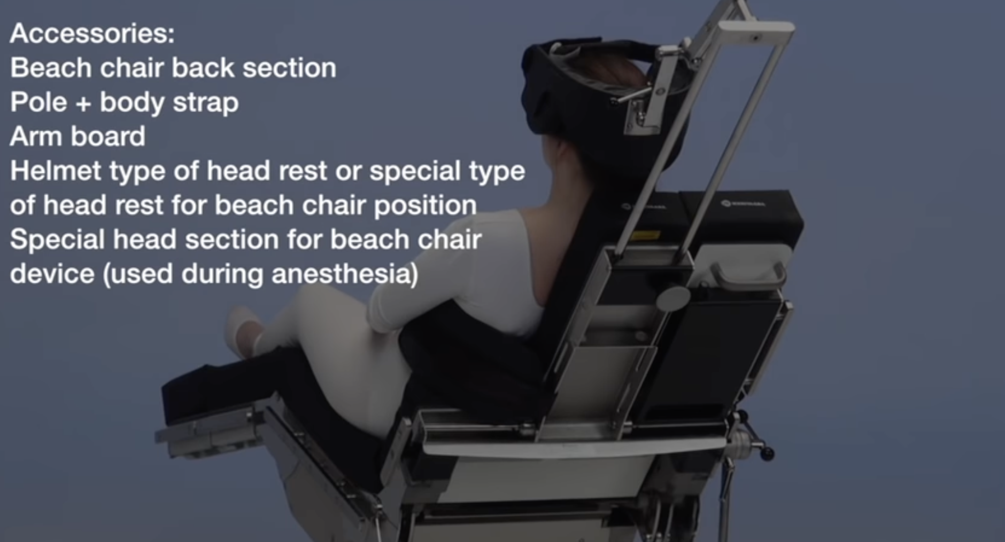
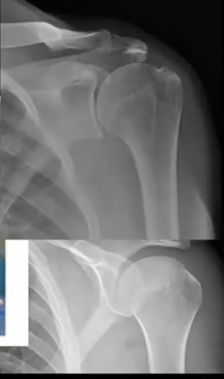

Slide 7
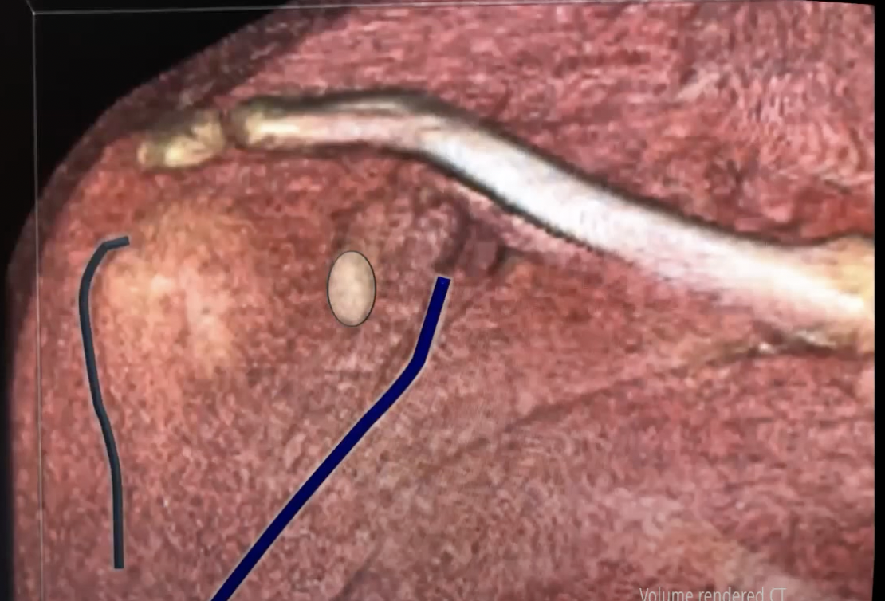
Indications
Setup
Incision
Superficial dissection
Deep dissection
Extension
and
Risks
What if you can’t find the cephalic vein?

Slide 8
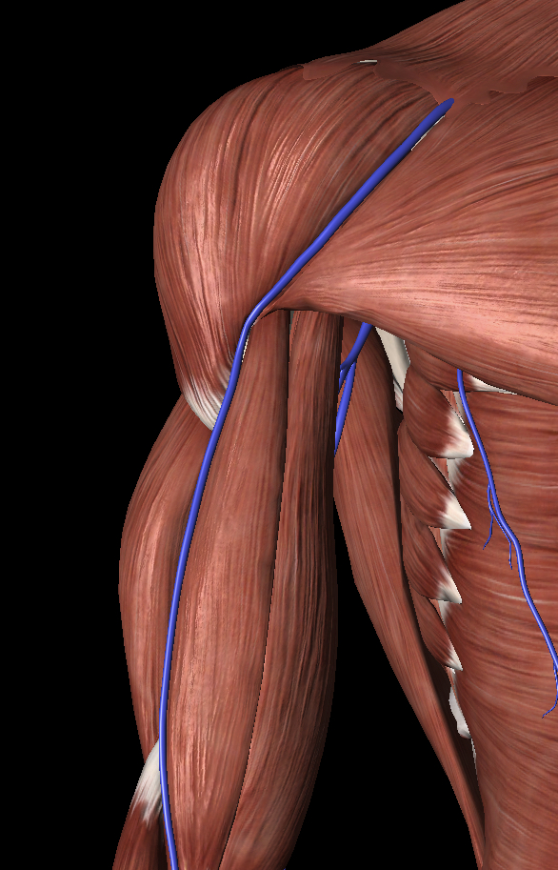
Indications
Setup
Incision
Superficial dissection
Deep dissection
Extension
and
Risks

Slide 9
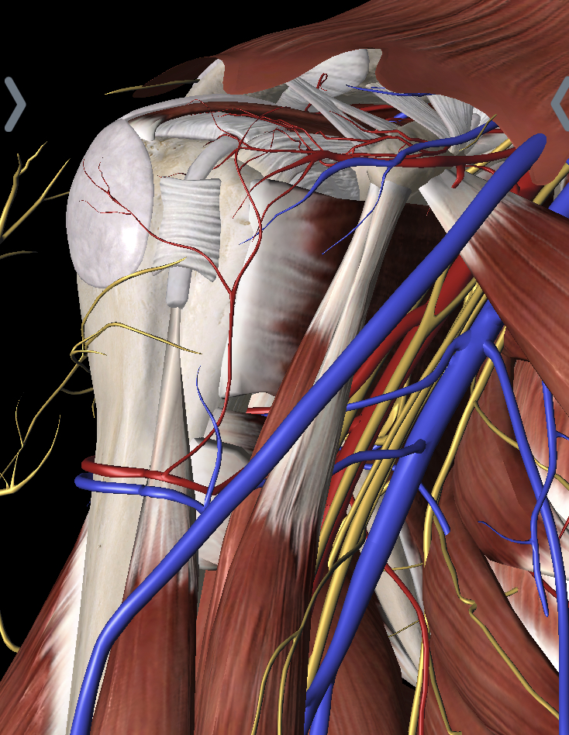
Lateral side
'Suicide’
Conjoin tendon
Lat dorsi insertion

Slide 10
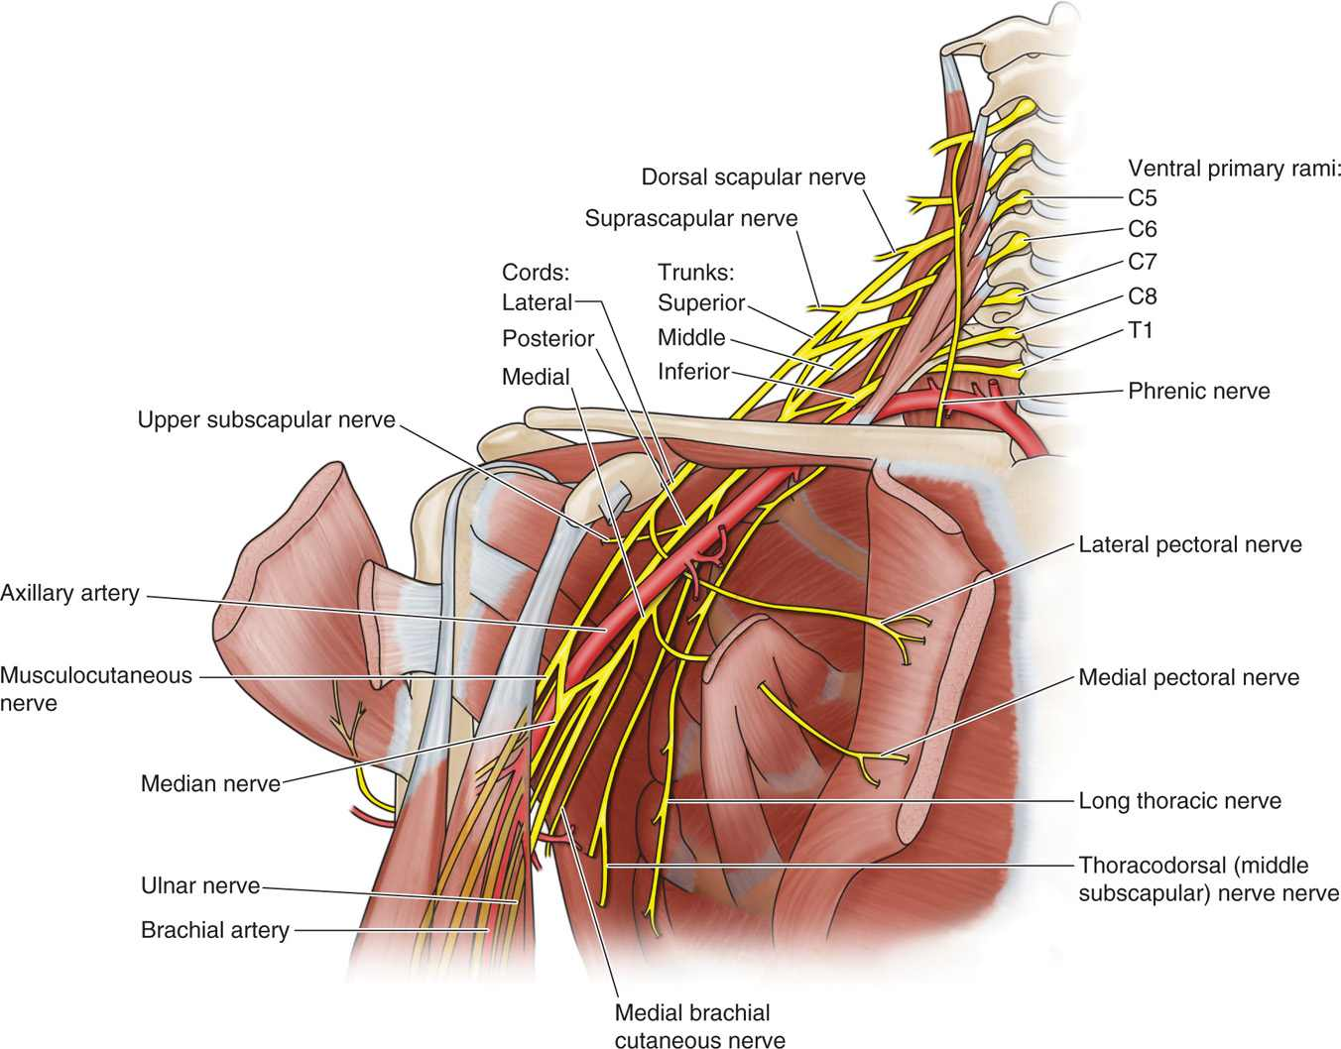
Brachial plexus
*
*
Notes:
Axillary
Musculocutaneous nerve
Lower subscapular nerve sits 2.5 cm below pectoral insertion on humerus

Slide 11
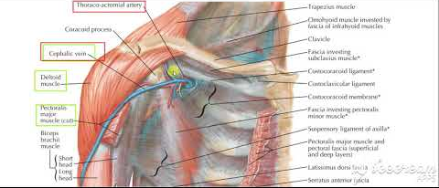

Slide 12


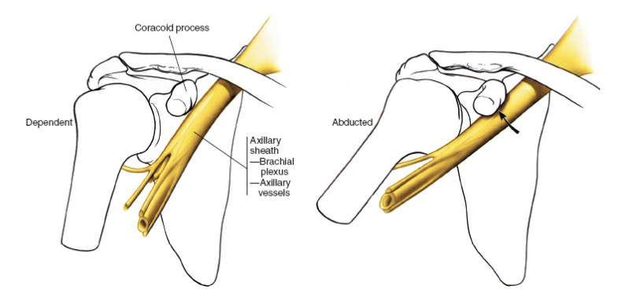
Lateral side
'Suicide’
How can you improve access?
What do you do with LHB?
How do you release subscap?
Lat dorsi insertion

Slide 13
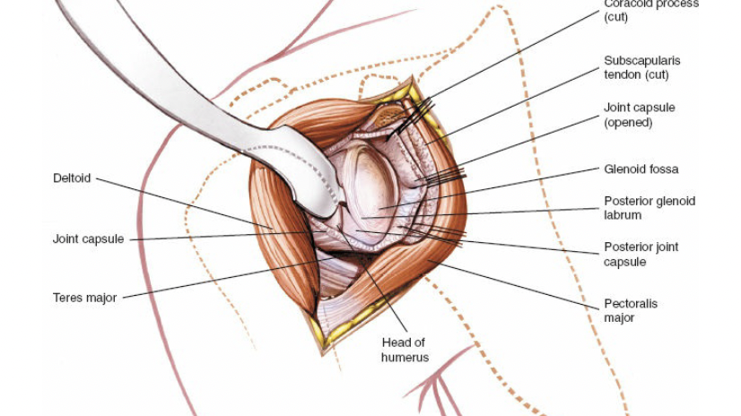

Slide 14
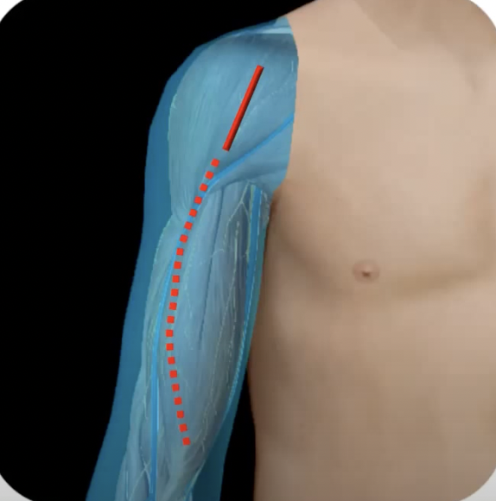

Slide 15
Risks
Indications
Setup
Incision
Superficial dissection
Deep dissection
Extension
and
Risks
Veins
Cephalic
Arteries
Anterior humeral circumflex “three sisters”
Posterior humeral circumflex
Nerves (avoid overzealous retraction)
Axillary (ER the arm)
Musculocutaneous nerve
Lower subscapular nerve sits 2.5 cm below pectoral insertion on humerus
Other?

Slide 16
