Slide 1
Lateral approach to proximal humerus (Deltoid split)
Hoppenfeld p.87

Slide 2

Deltoid split
Indications
Setup
Incision
Superficial dissection
Deep dissection
Extension
and
Risks

Slide 3
Indications
Indications
Setup
Incision
Superficial dissection
Deep dissection
Extension
and
Risks
Elective
Supraspinatous repair (”limited” / McKenzie)
Trauma
Humeral nail insertion
GT fractures
Alternatives…?

Slide 4
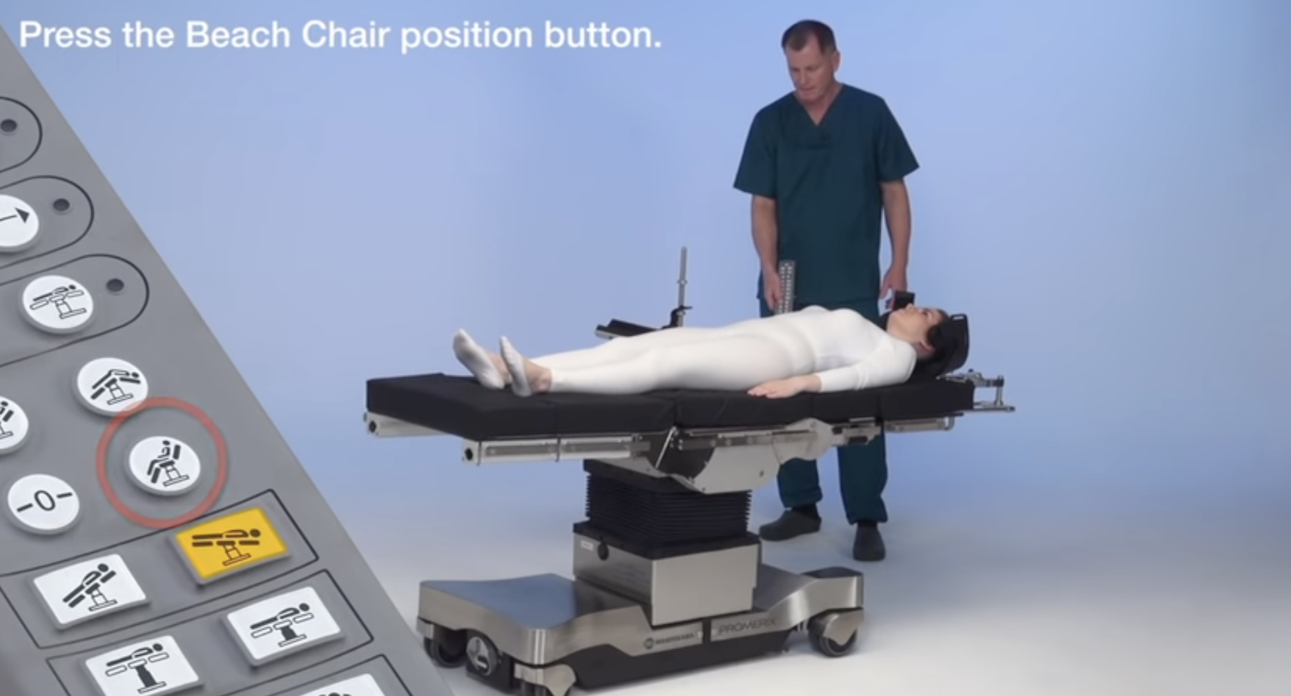
Setup

Slide 5
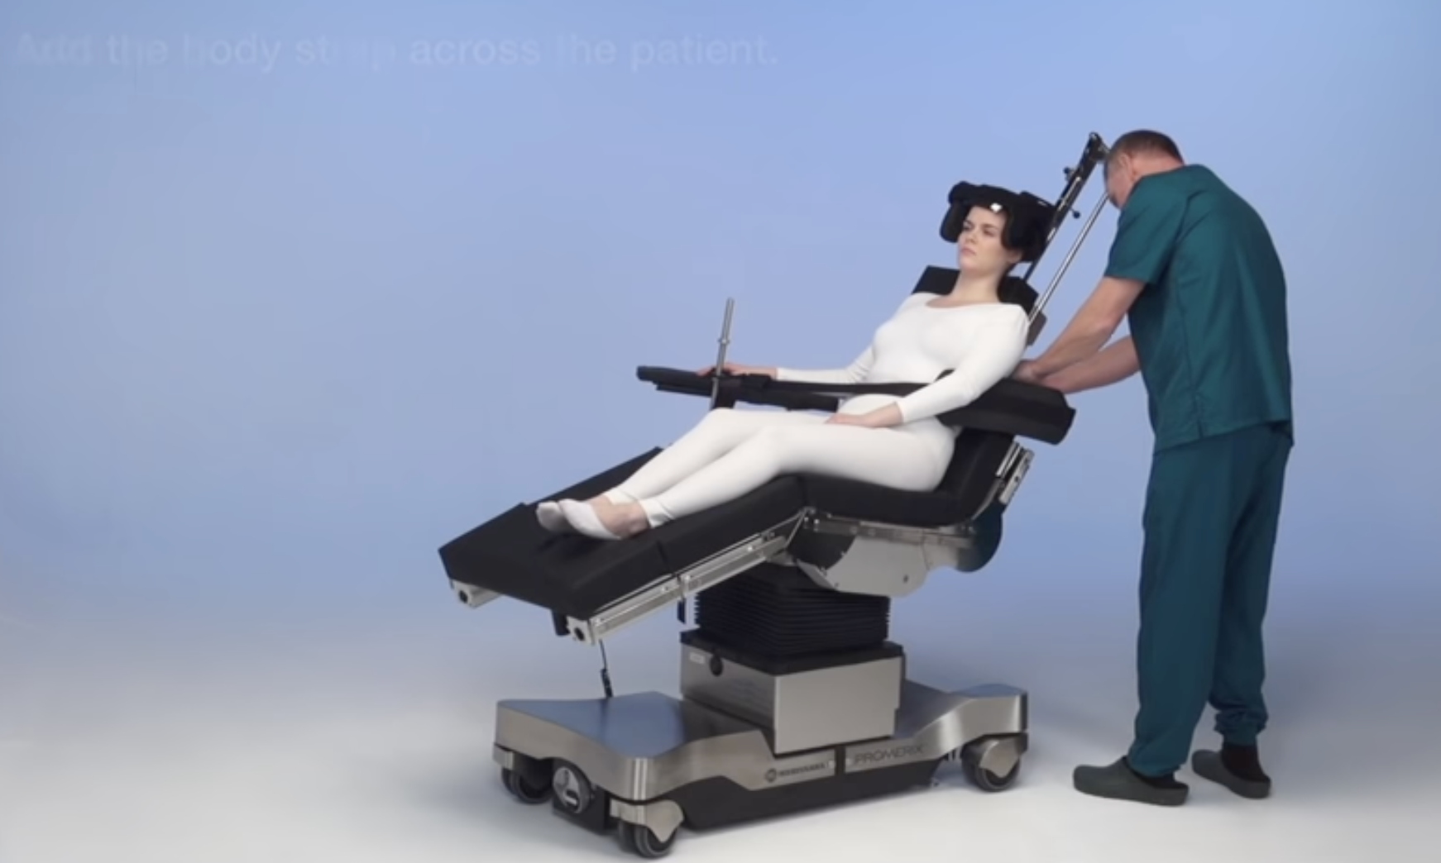
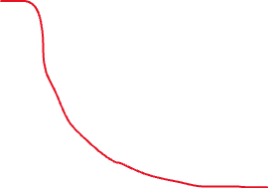

*
*
*

Slide 6
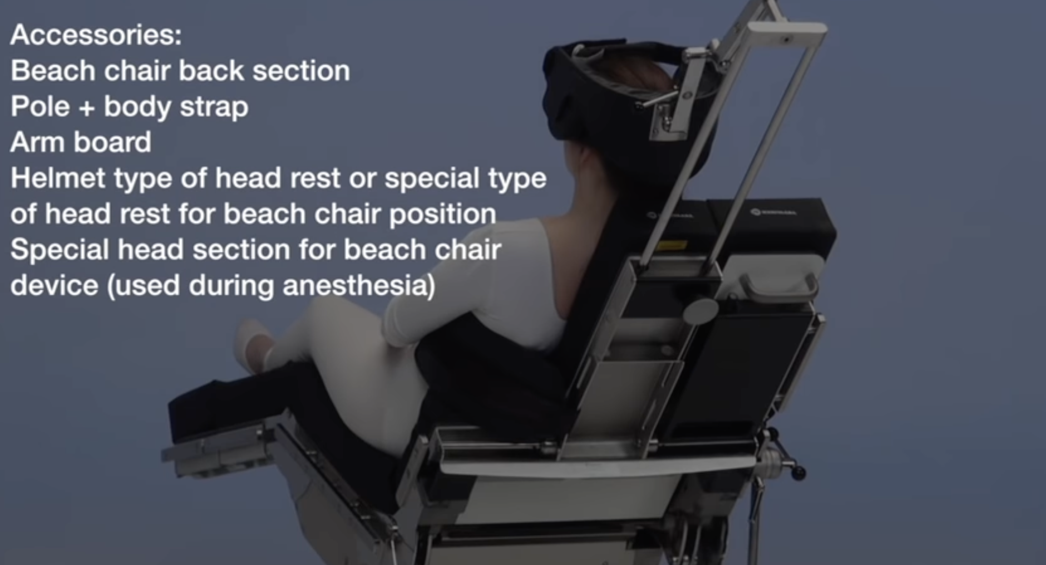
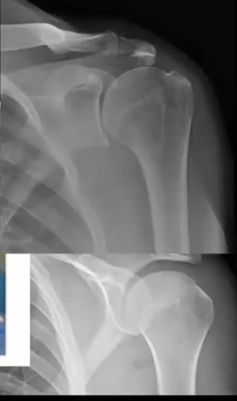

Slide 7
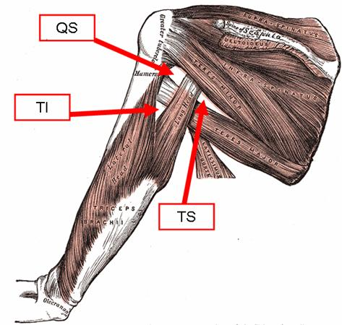
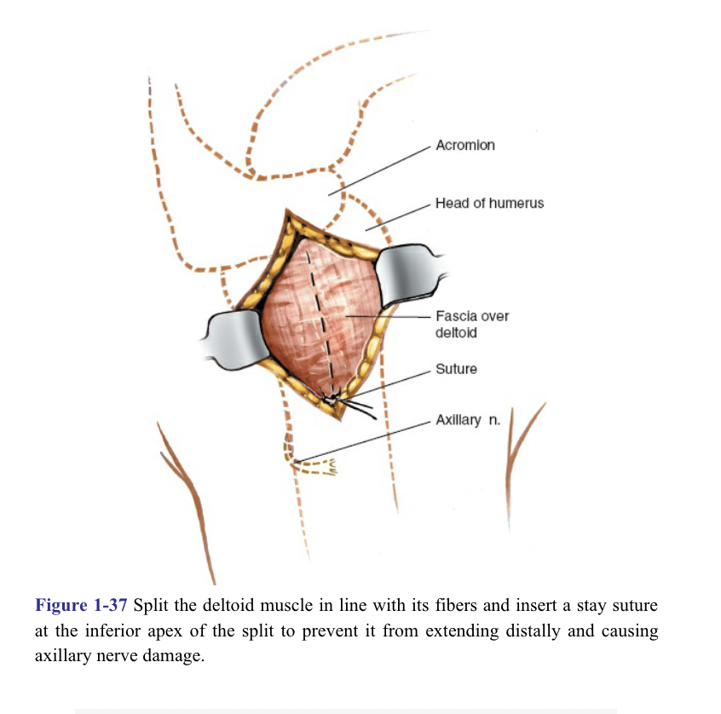
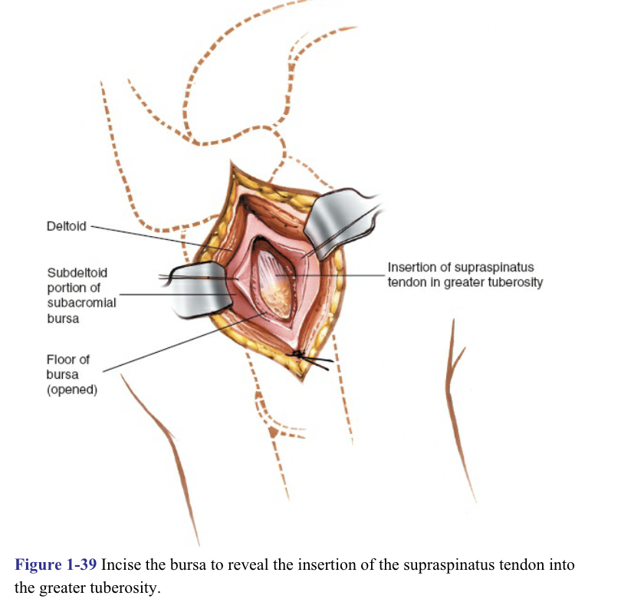
4-6cm

Slide 8
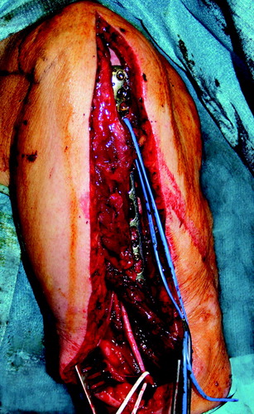
Risks
Indications
Setup
Incision
Superficial dissection
Deep dissection
Extension
and
Risks
Veins
Arteries
Nerves
Axillary
Other?

Slide 9
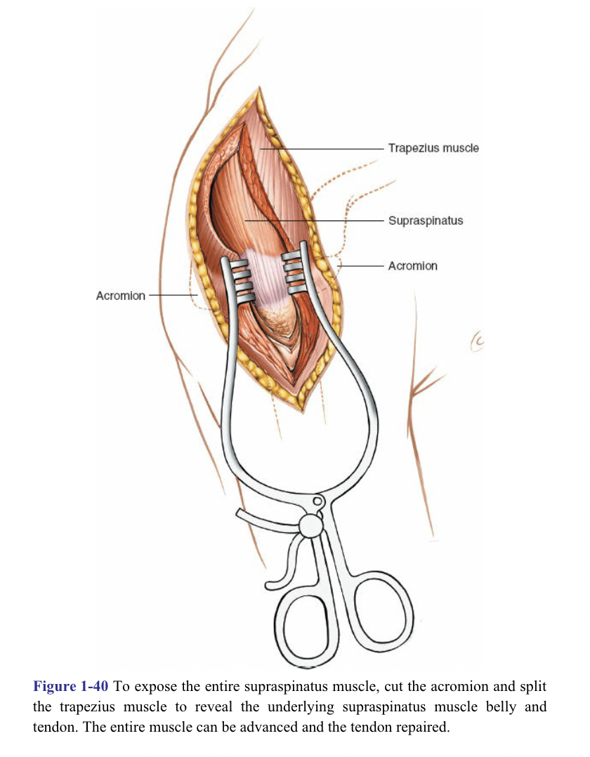
Extension
https://doi.org/10.1302/0301-620X.93B3.25818

Slide 10

Anatomy Feedback

Slide 11

Oops Pre-event questionnaire

