Slide 1

Diagnosing carpal fracture / dislocations

Slide 2
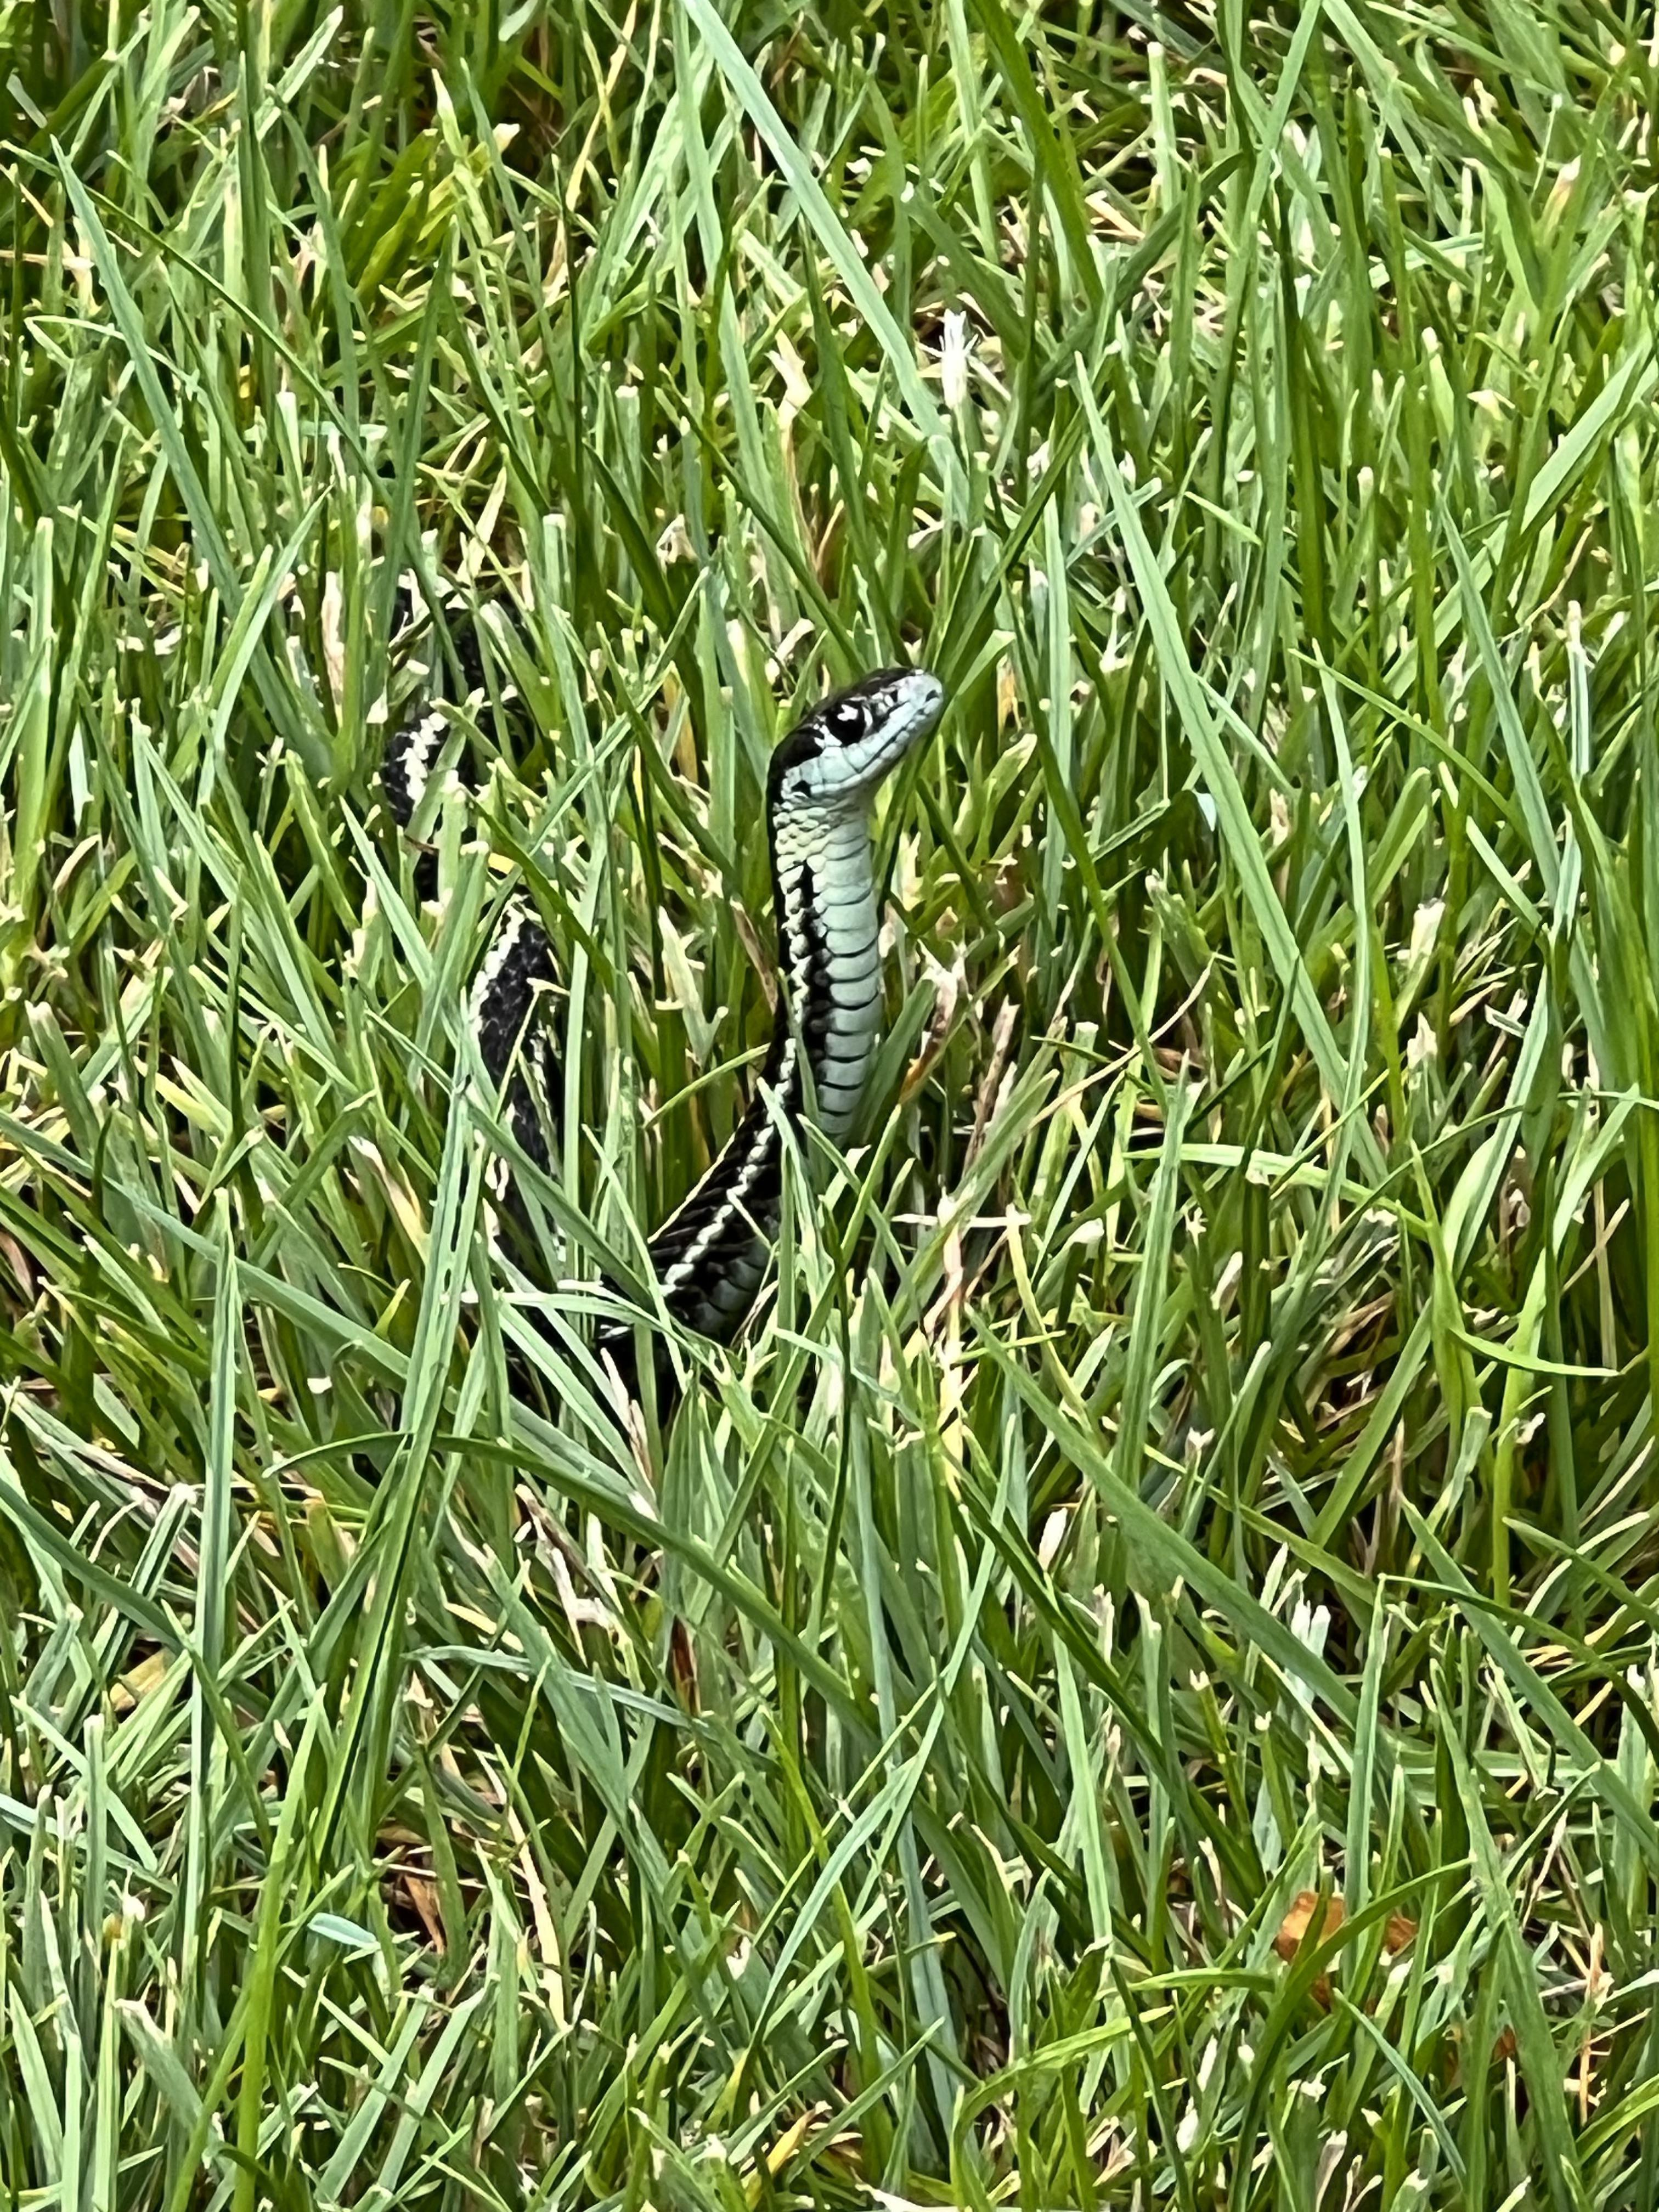
- (?) 5% of wrist injuries - 25% missed at initial presentation - Dire & unsalvageable consequences

Slide 3
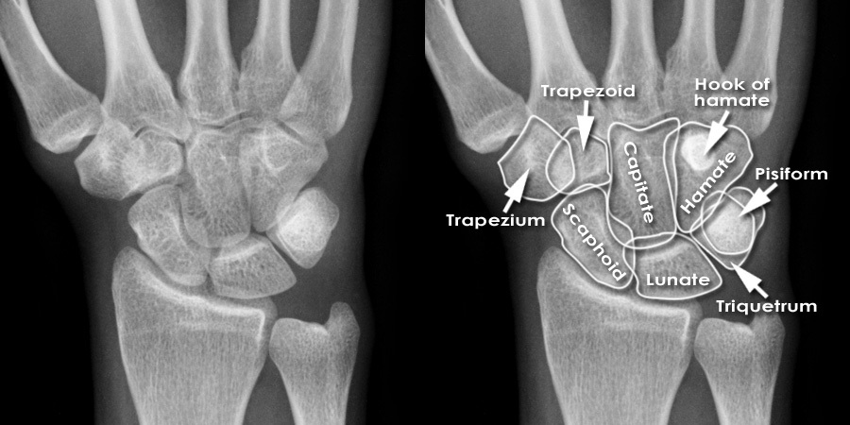

Know what’s normal

Slide 4
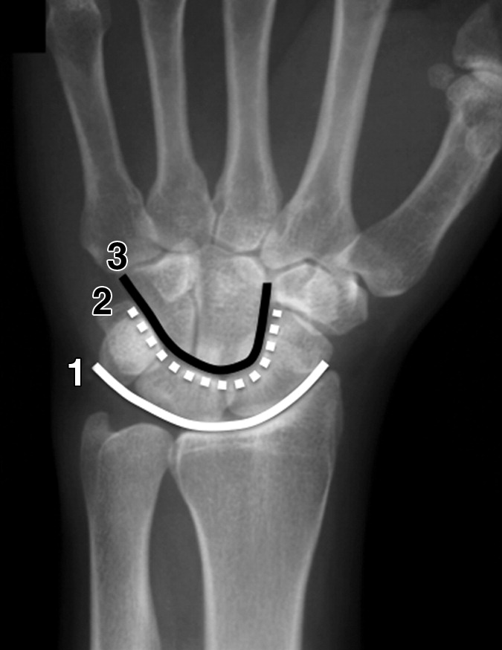
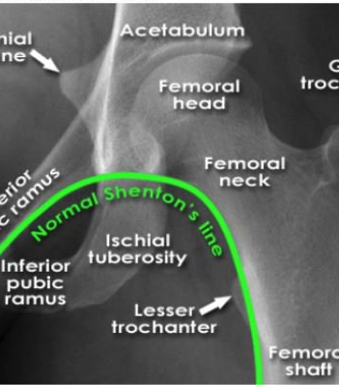
AP
GILULA 1979

Slide 5
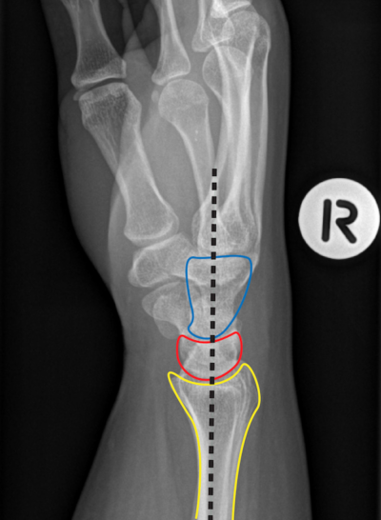
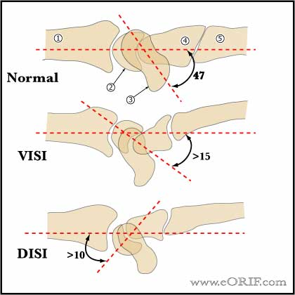
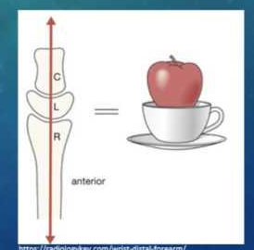
LAT
Scaphoid

Slide 6
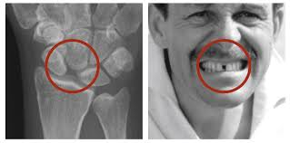
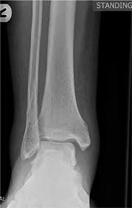

Slide 7
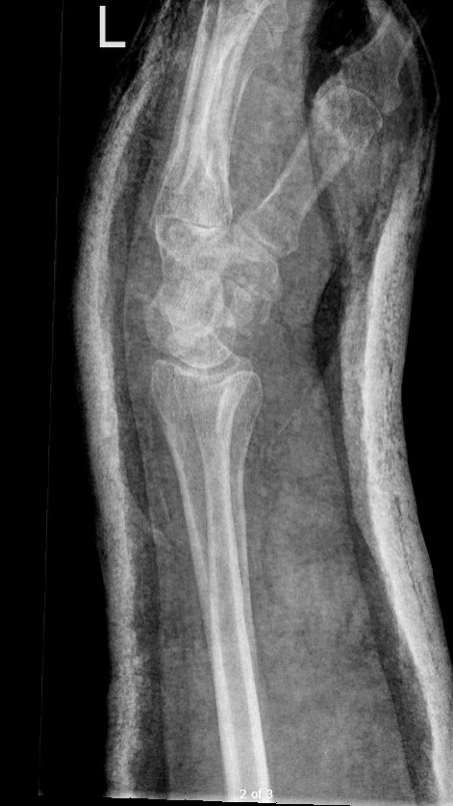
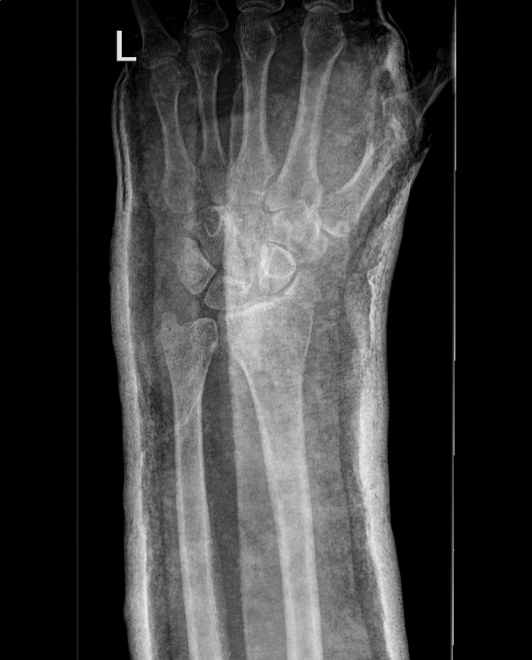

Slide 8
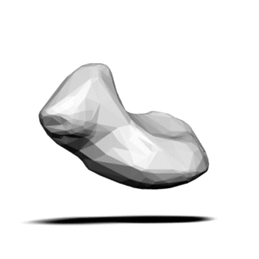
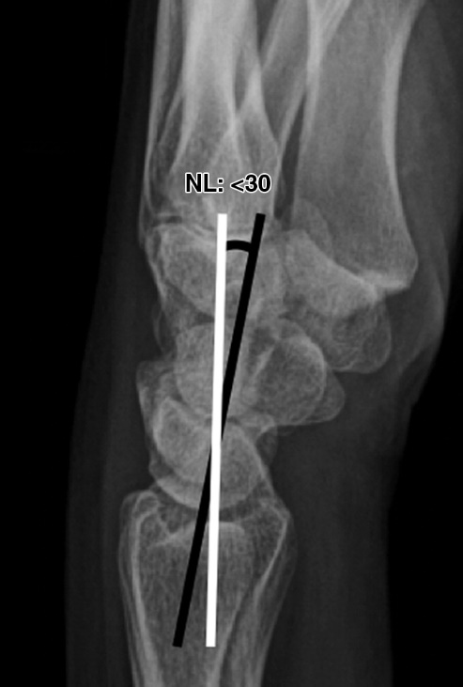

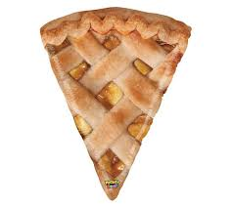

Slide 9
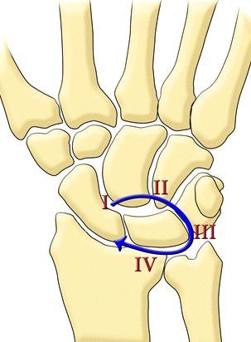


Injuries around
the lunate
Mayfield 1980

Slide 10
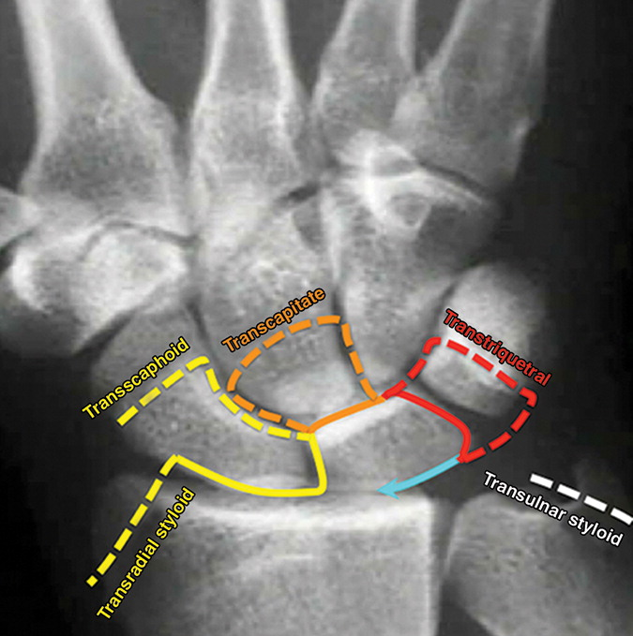
TFCC tears
Non displaced fractures
Normal SLL

Slide 11
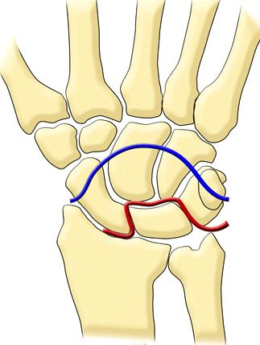
Lunate in situ
Greater arc
90% trans-scaphoid
10% trans radial-styloid
Lesser arc
Purely ligamentous
MRI

Slide 12
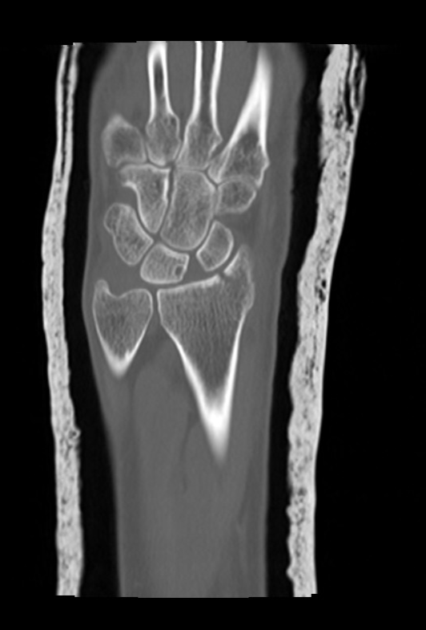
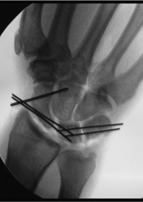

Slide 13
Precursor injuries
Mayfield 1980

Slide 14
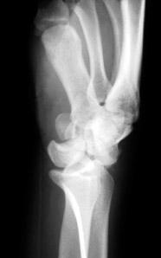
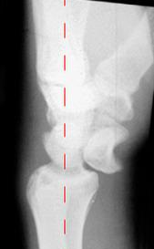
Perilunate dislocation
Lunate dislocation

Slide 15
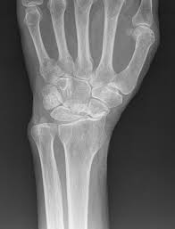
Red flag presentations Careful inspection of ALL Xrays Subspecialist opinion / advanced imaging

